Slide 1

Wel - Come

Slide 2
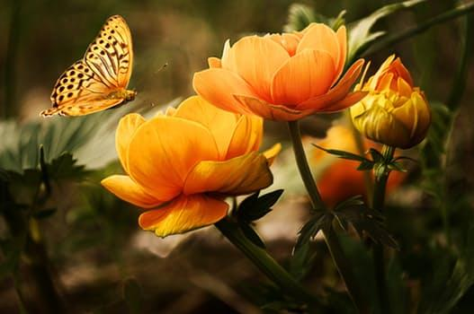
ANNUAL FUNCTION
2016-2017

Slide 3
WELCOME
VIDYACHANDRA EDUCATION AND WELFARE TRUST
VIDYACHANDRA’S “MY HOME”
ENGLISH MEDIUM SCHOOL,
SNEH NAGAR, MHASRUL
NASHIK - 422004

Slide 4

WELCOME
WELCOME

Slide 5


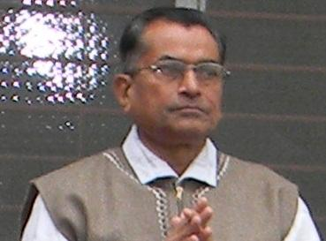
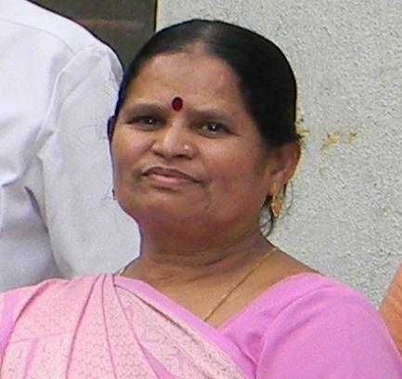
HONOURABLE TRUSTEE
MR. S.P.JAIN -
MRS.V.S.JAIN

Slide 6

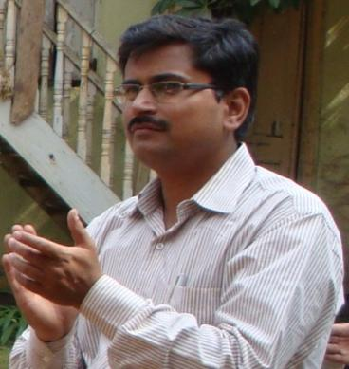
MANAGING DIRECTOR
DR.VIRENDRA JAIN
M.D.

Slide 7
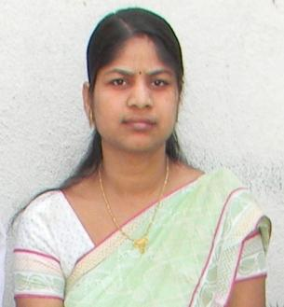
OUR PRINCIPAL
DR.ARTI V. JAIN
B.A.M.S. DSM.

Slide 8

STARTED WITH PRI-PRIMARY IN YEAR 2006.
We started with 22 students & today we have 400 + students

Slide 9
We are Gov.Recognised. state board
C.B.S.E pattern school
The school to reach std 10th as
per natural growth.

Slide 10
Next year admission open for playgroup to std. 10th

Slide 11
Our specialty 30 students per class with aim for tuition free education.
Concept understanding.

Slide 12
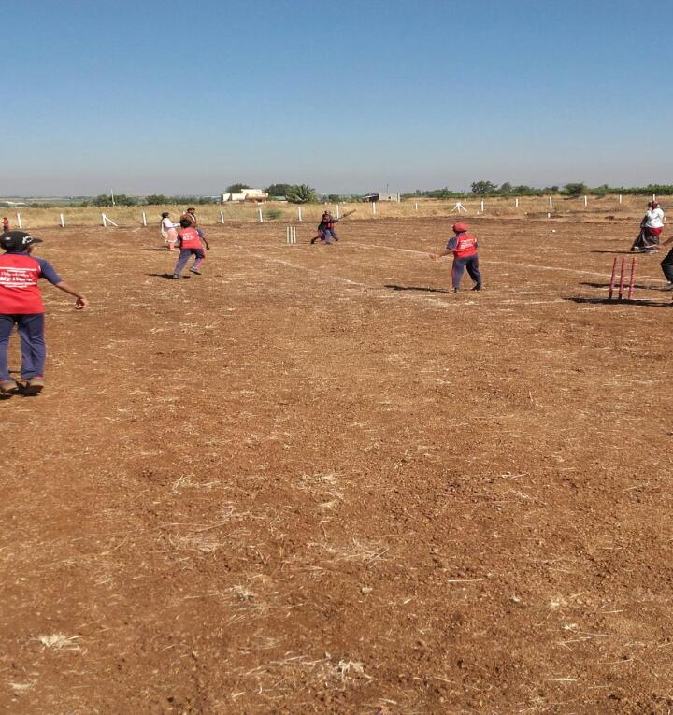
New Place

Slide 13
Towards Our Dream
Our Progress
New Place
English
Medium
Semi English
Medium
Jr. College
P.G
Sr.
College
Behind –M.U.H.S. Manori.

Slide 14

SPECIAL ACTIVITY IN OUR SCHOOL
Extra classes
Special coaching with question bank
News Paper Reading
Indoor games- Chess Carom
Outdoor games-Throw ball, track events, badminton.
Cooking Activity
Skating
English speaking class
Library Facility (1030 Books)
Environmental Care.
Hypnotism; Meditation.
Karate.
Medical check up(All time doctor present ladies & gents. )

Slide 15
Audio-visual Library.
Personality Development.
Quiz Session. Every Saturday.
Social Responsibility.
Yoga section.
Music, Tabla ,harmonium, dance.
Annual Function.

Slide 16
CELEBRATIONS
Independence Day
Gokulashtami
Teacher’s Day
Ganesh chaturthi
Navratri dandiya
Gandhi Jayanti
Diwali Celebration
Rakshabandhan

Slide 17
ACTIVITIES
Green day ,Red day, White day, Yellow day
Vegetable pared & fruit pared
Chart making
Rakhi making & sticking compition
Flag coloring compition
Ruturang day
Greeting making
Radha Krishna dress up compition
Fancy dress –Rain creature , our helper, Great leader
Toy day, Plantation, Road safety day
Gandhi dress up compition
Diya making

Slide 18
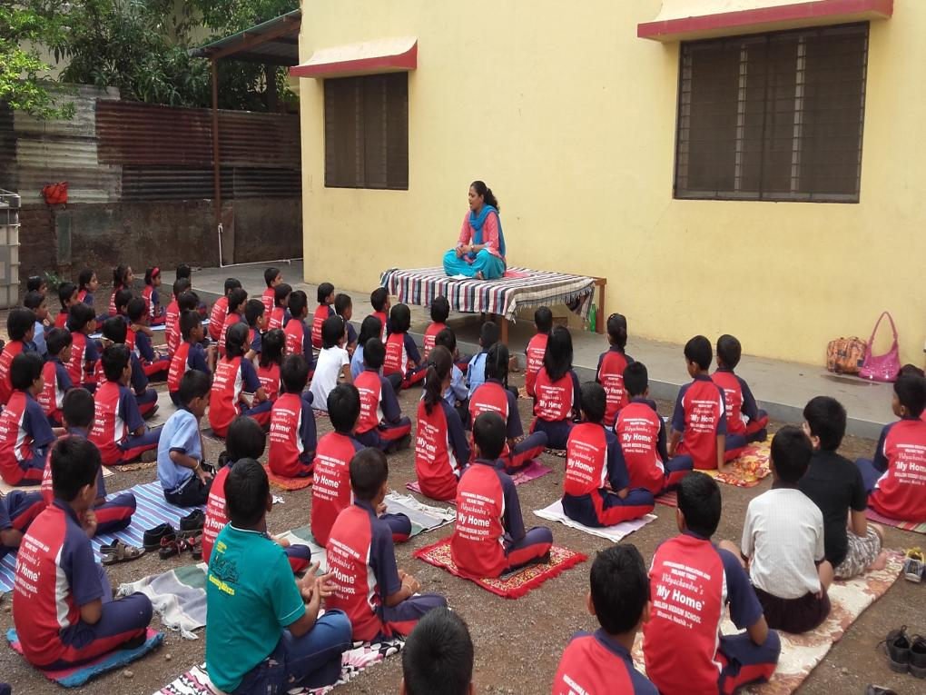
YOGA DAY

Slide 19
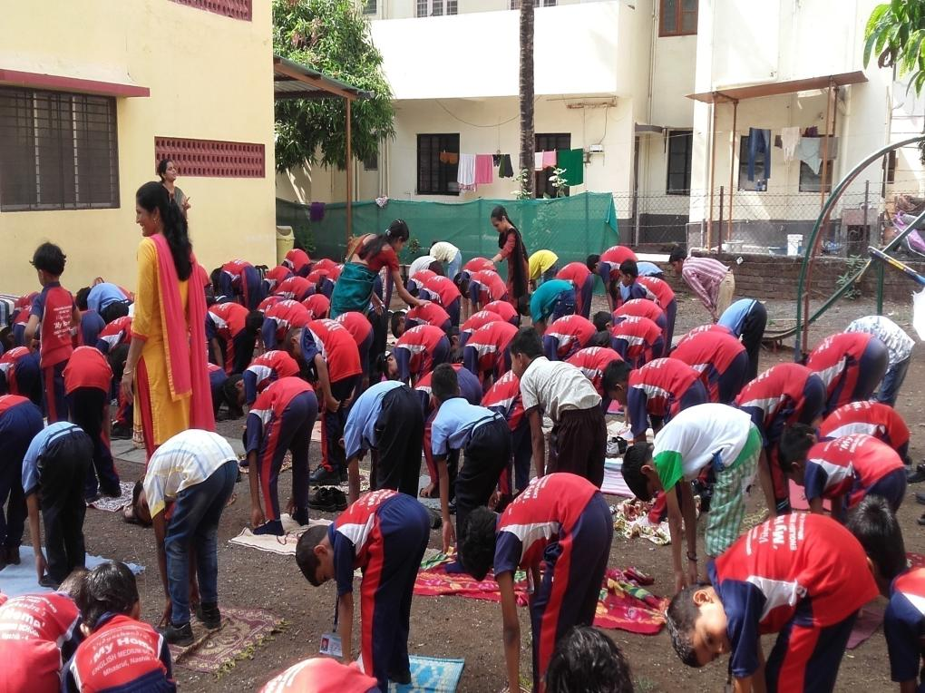
YOGA DAY

Slide 20
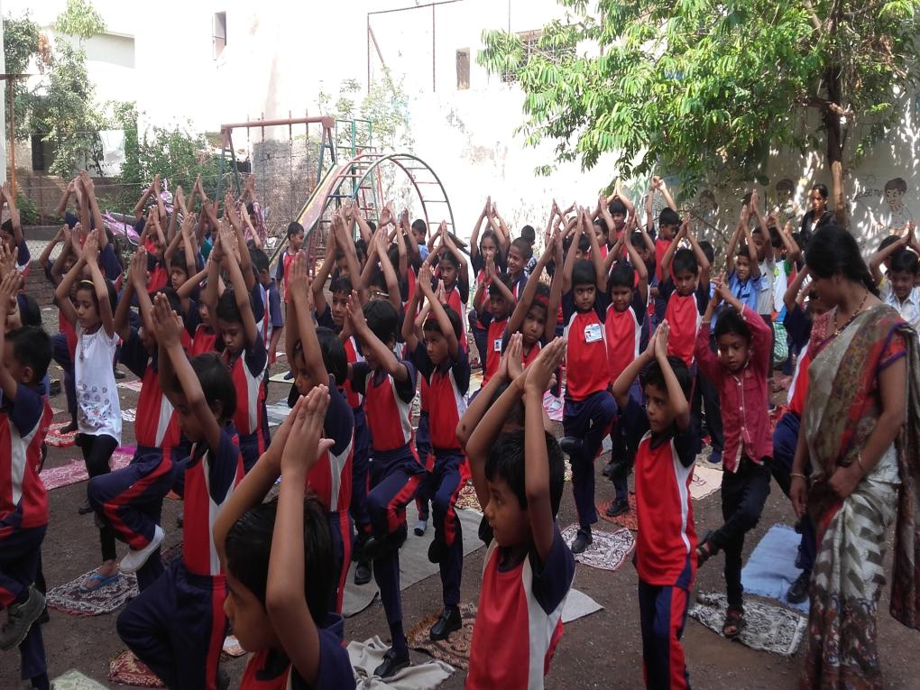
YOGA DAY
Notes:
Yoga day

Slide 21
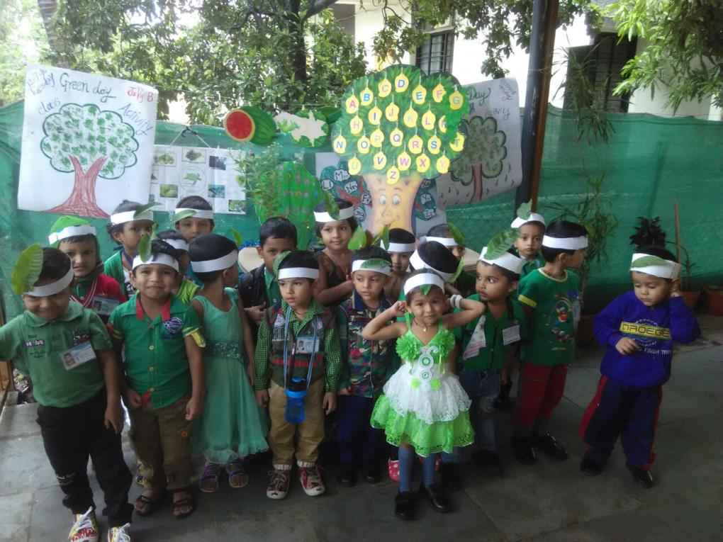
GREEN DAY

Slide 22
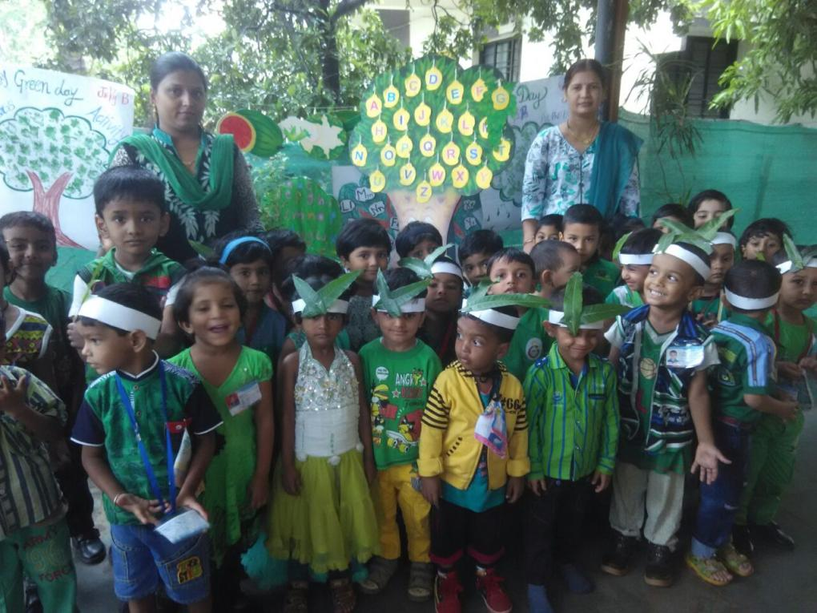
GREEN DAY

Slide 23
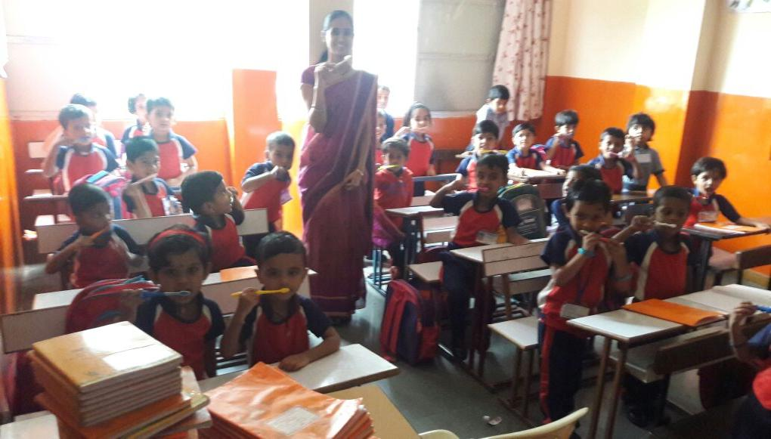
TEETH CARE DAY

Slide 24
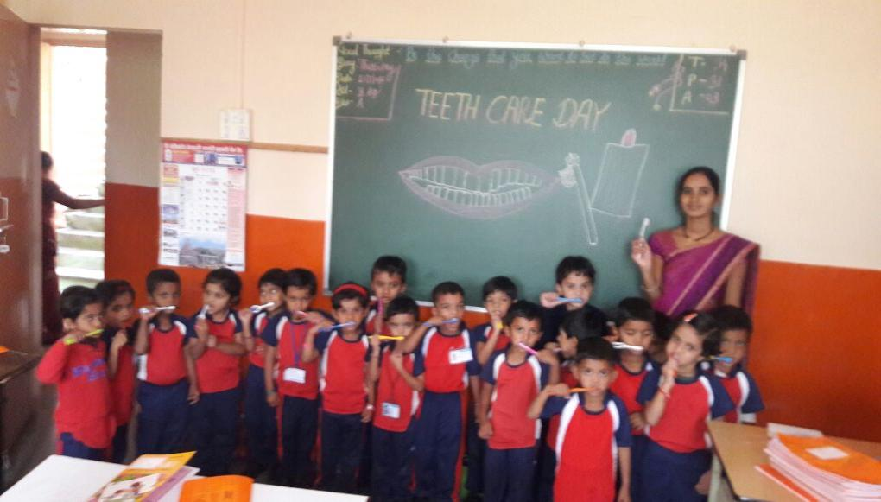
TEETH CARE DAY

Slide 25
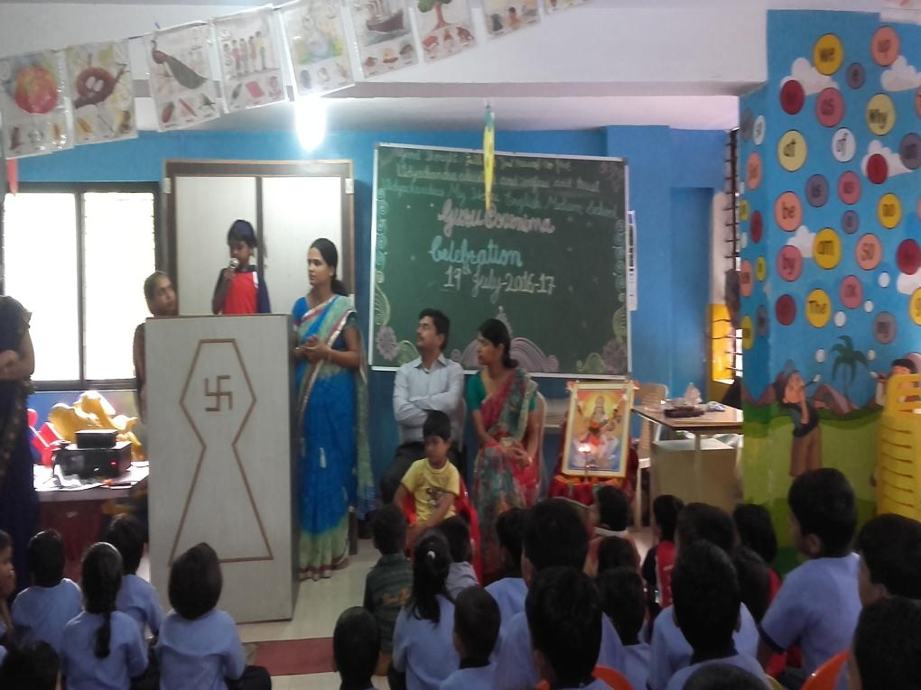
GURU PORNIMA

Slide 26
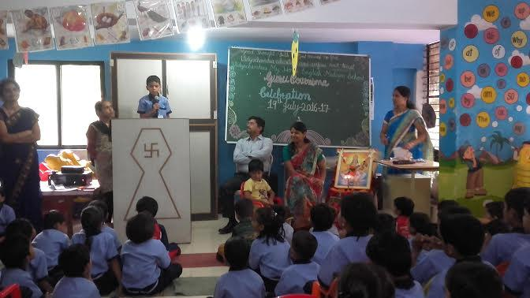
GURU PORNIMA

Slide 27
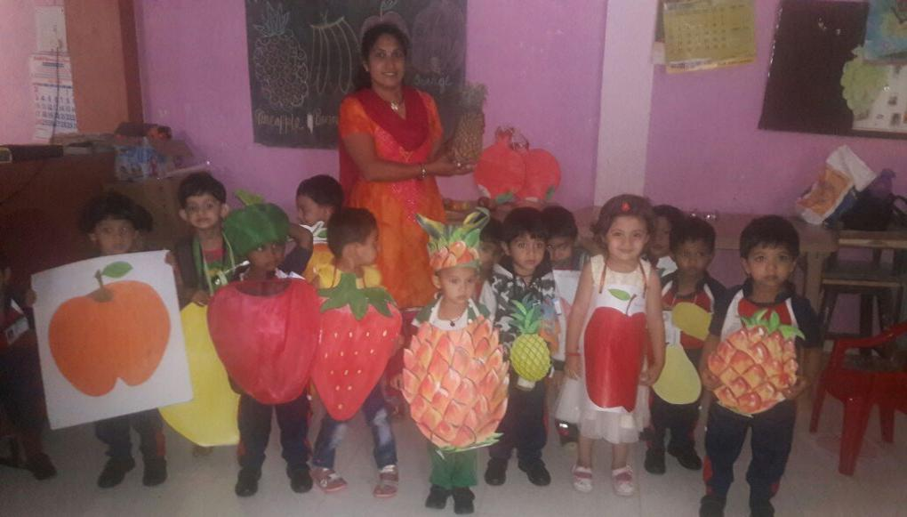
Fruit pared

Slide 28
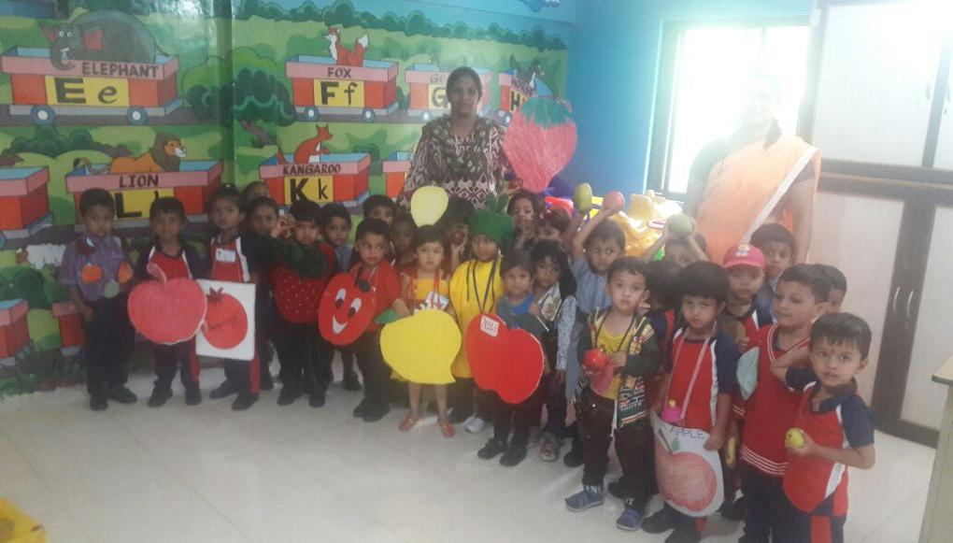
Fruit
pared

Slide 29
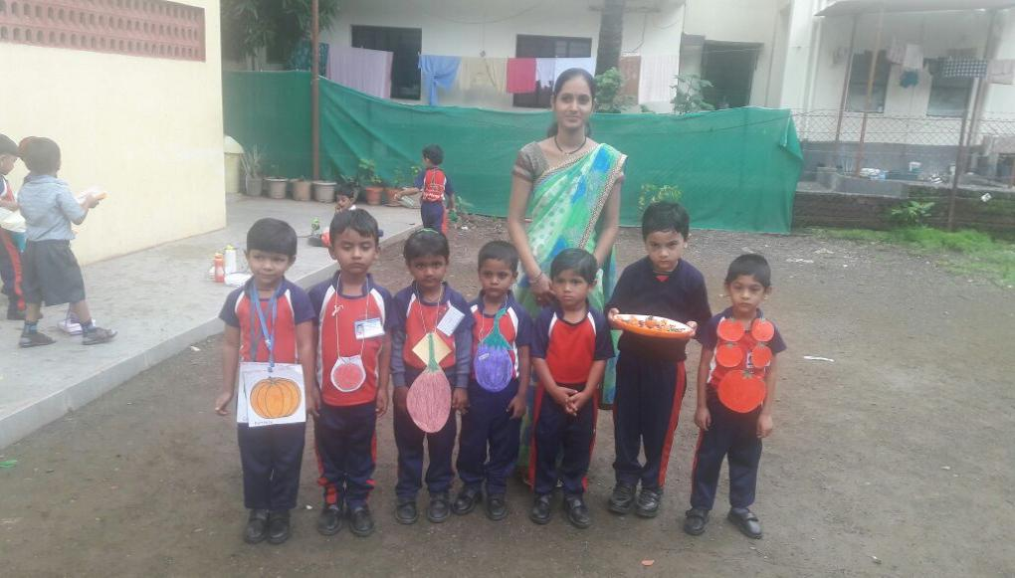
Vegetable Pared

Slide 30
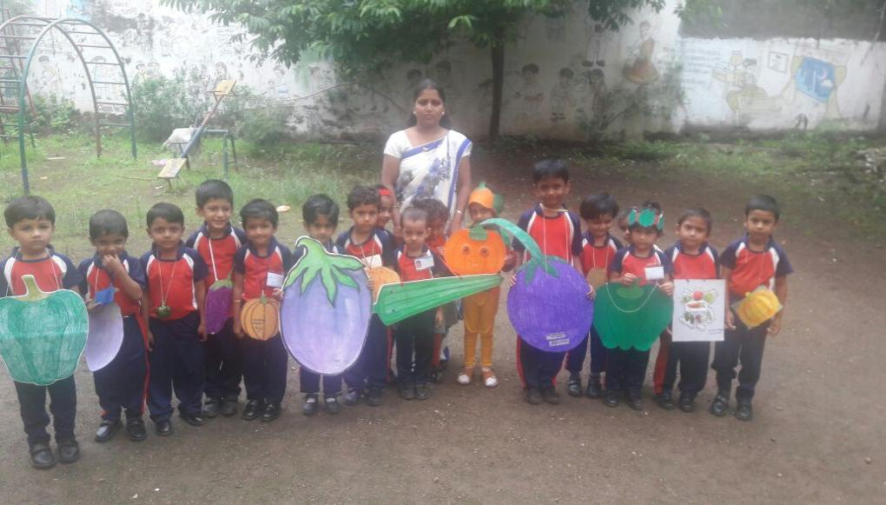
Vegetable Pared

Slide 31
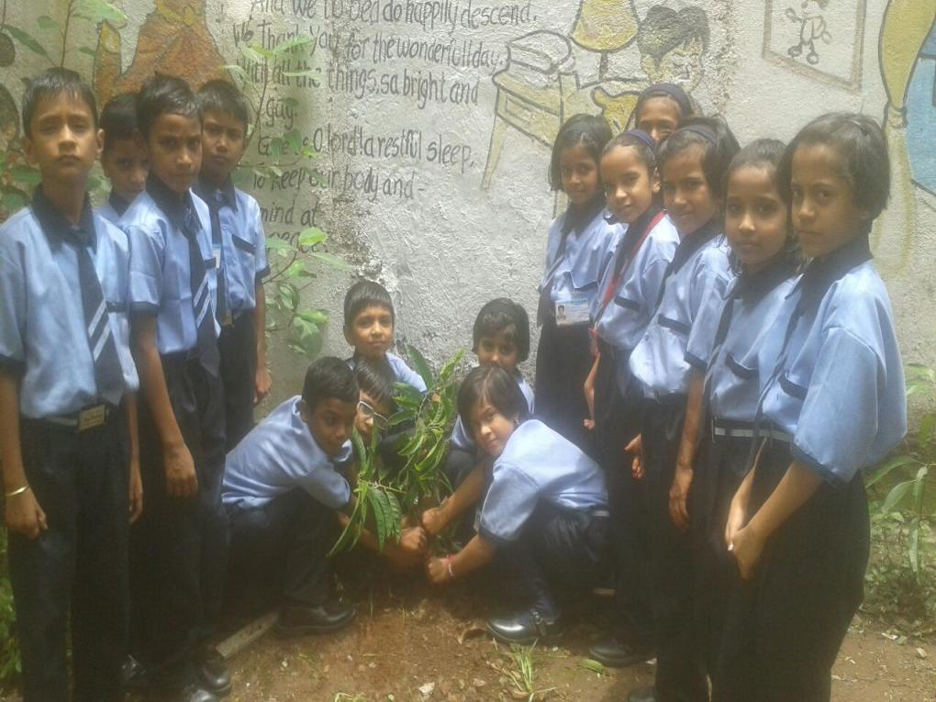
Tree Plantation

Slide 32
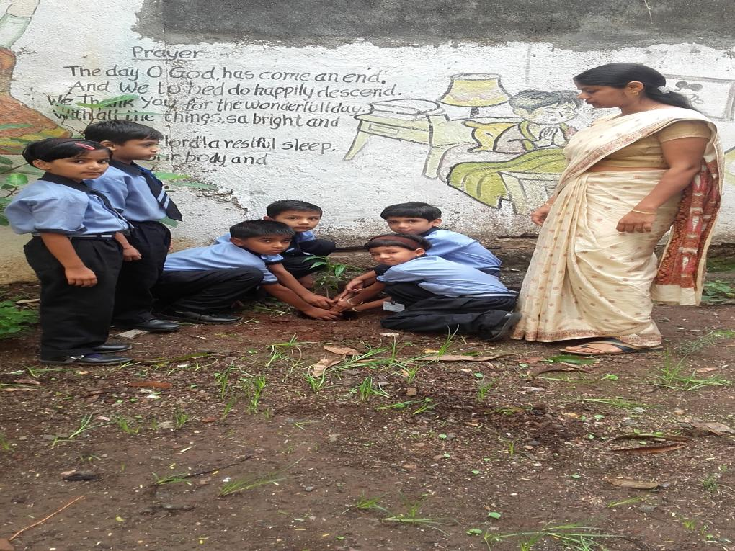
Tree Plantation

Slide 33
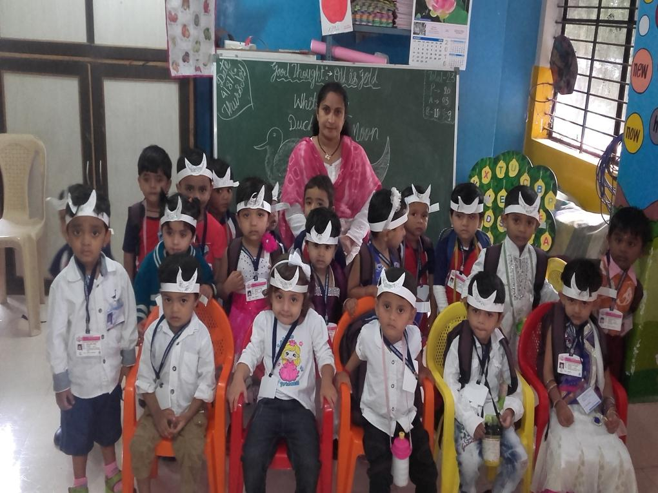
White day

Slide 34
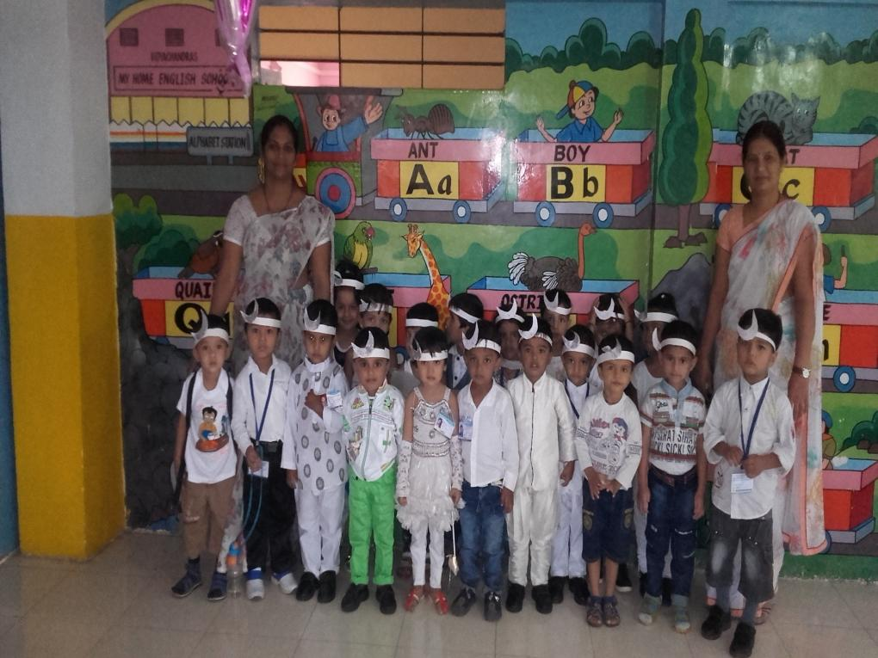
White day

Slide 35
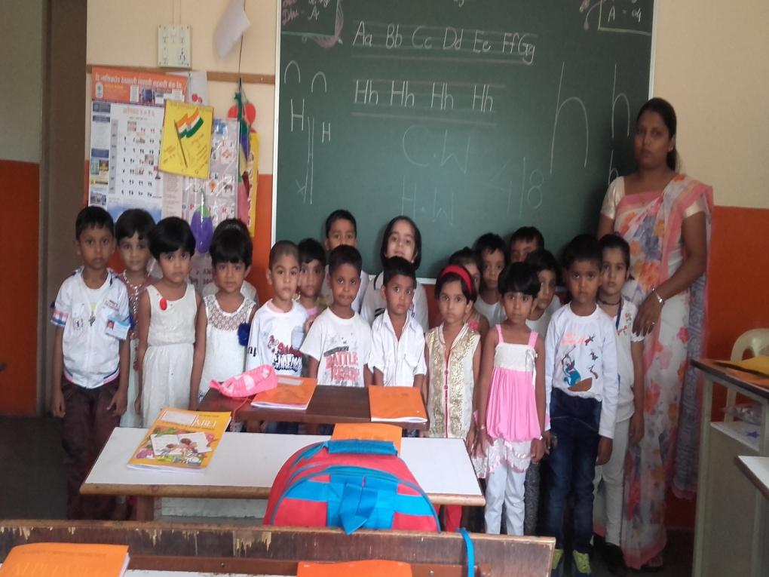
White day

Slide 36
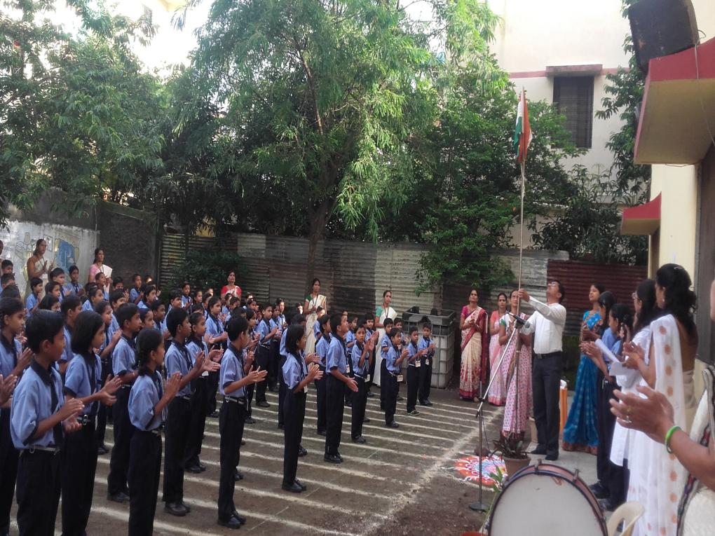
Independence day

Slide 37
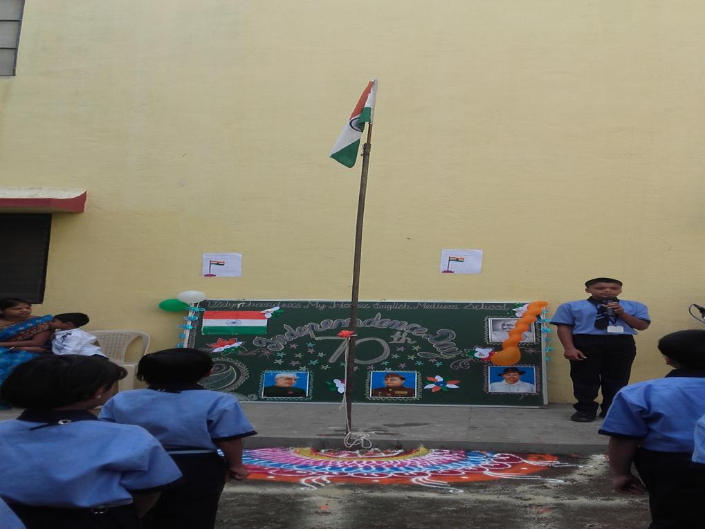
Independence day

Slide 38
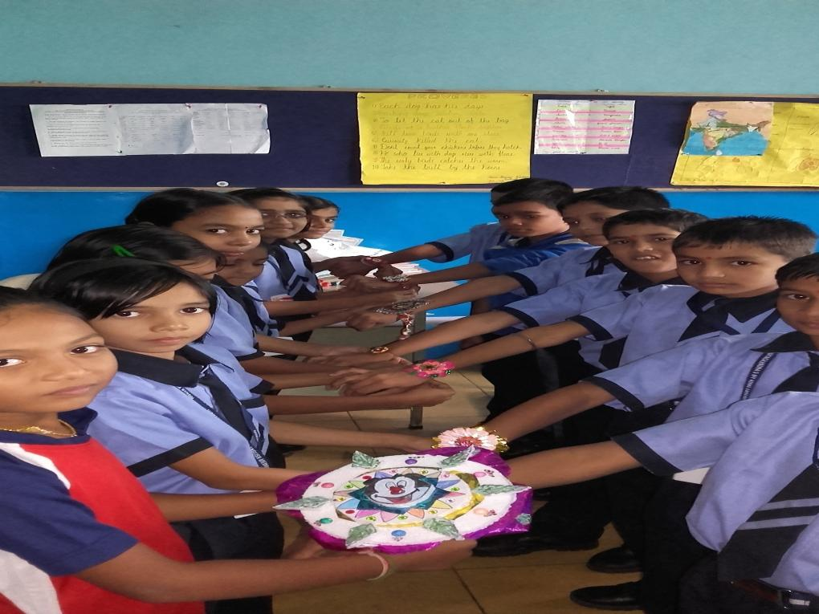
Raksha Bandhan

Slide 39
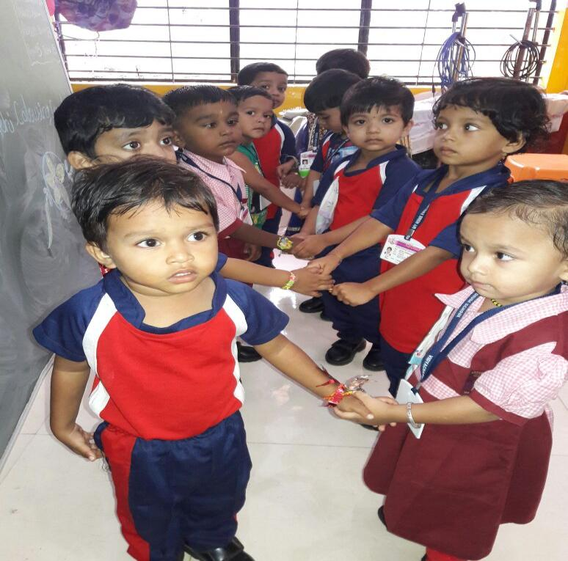
Raksha Bandhan

Slide 40
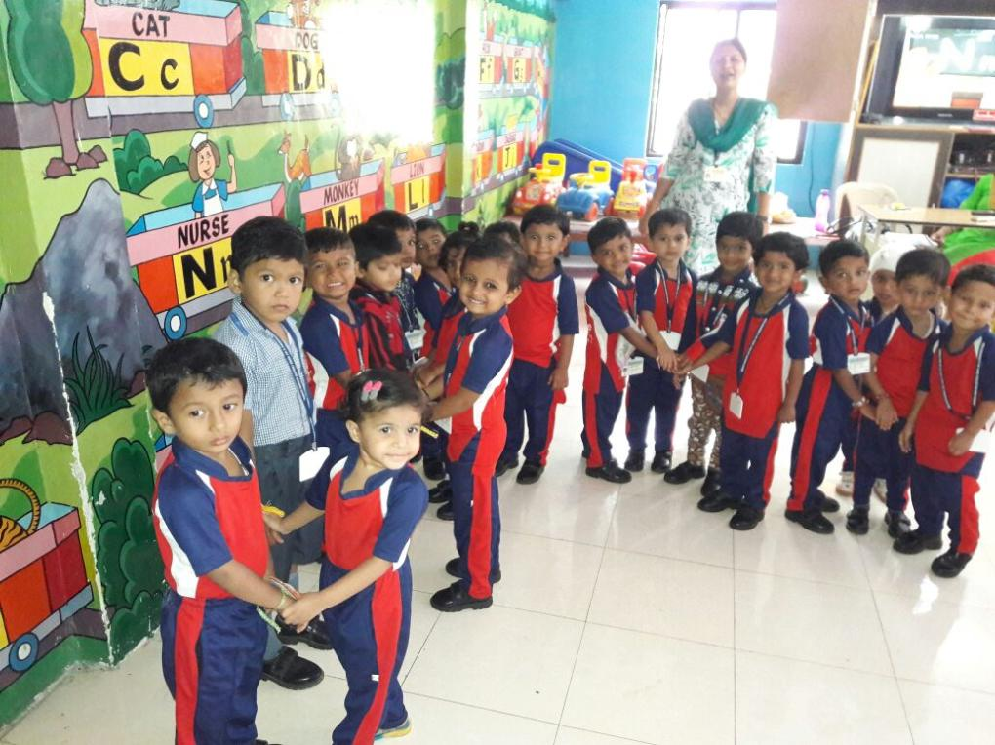
Raksha Bandhan

Slide 41
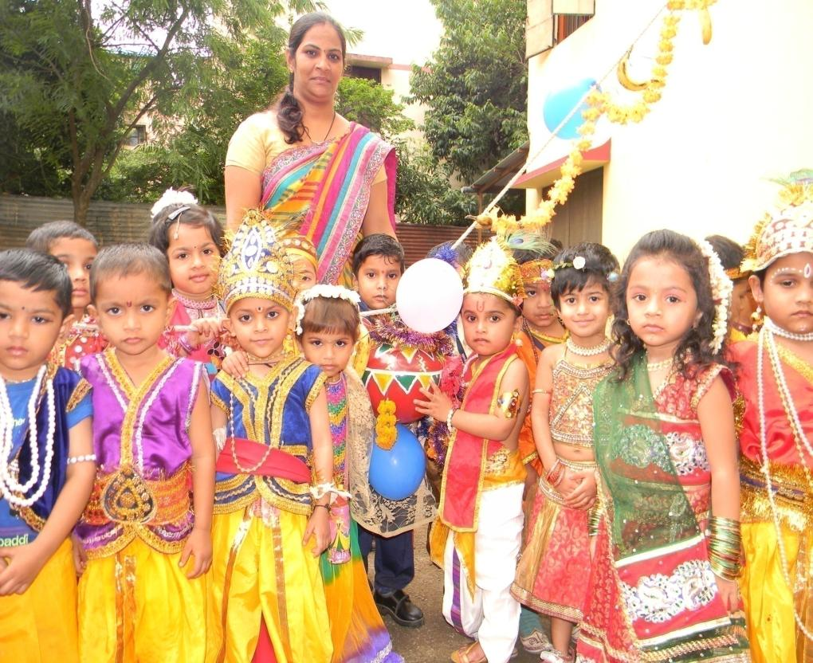
Radha
Krishna

Slide 42
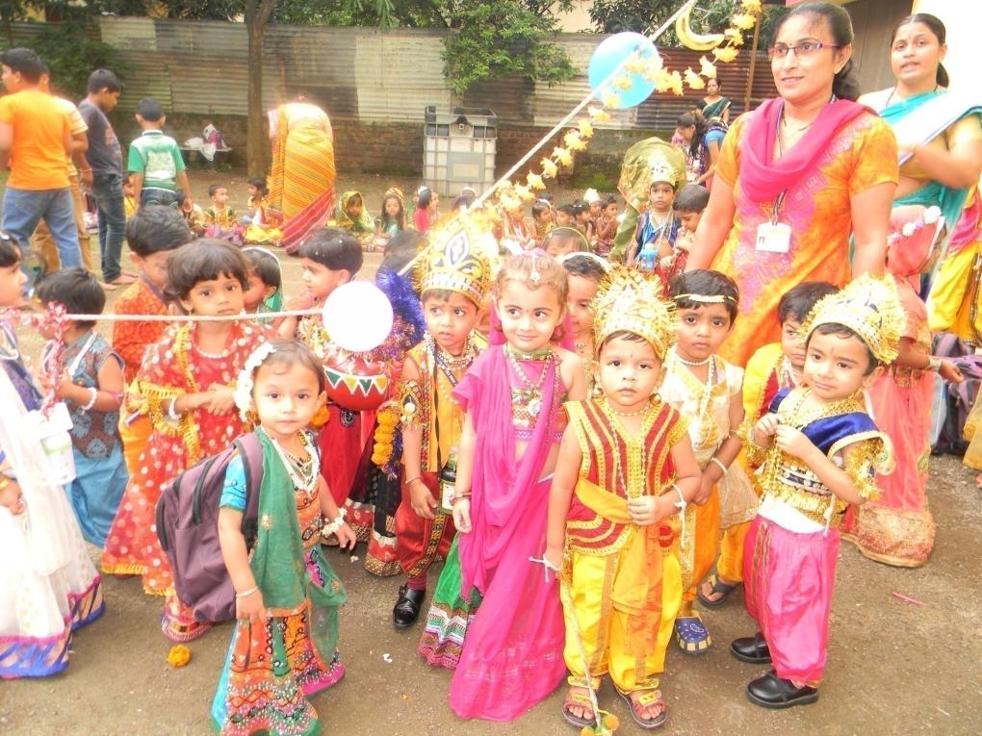
Radha Krishna

Slide 43
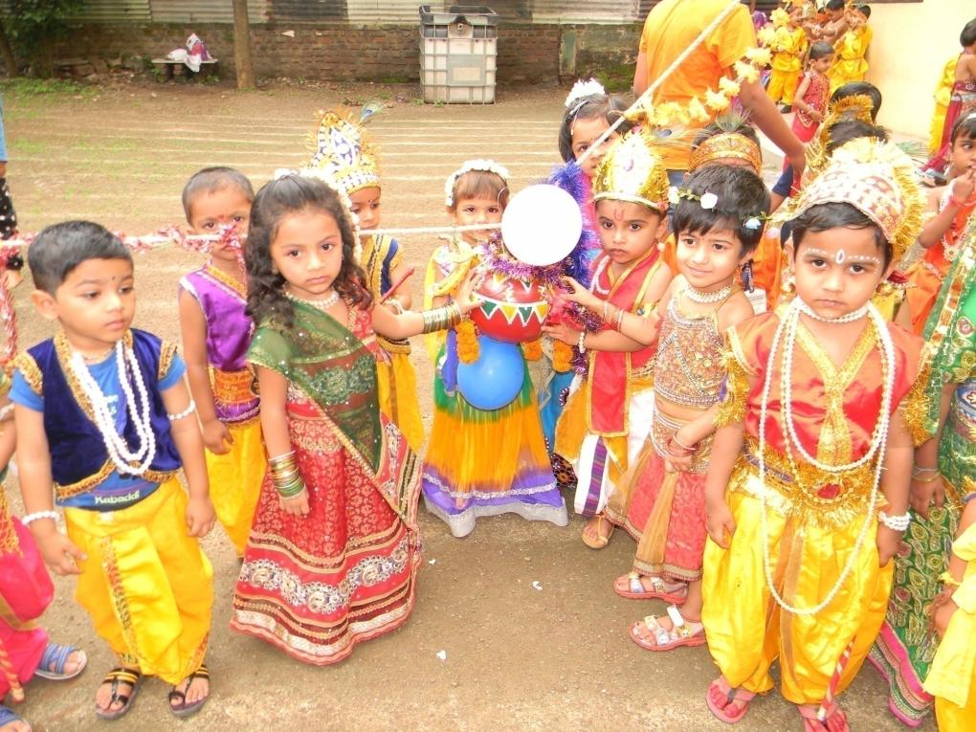
Radha Krishna

Slide 44
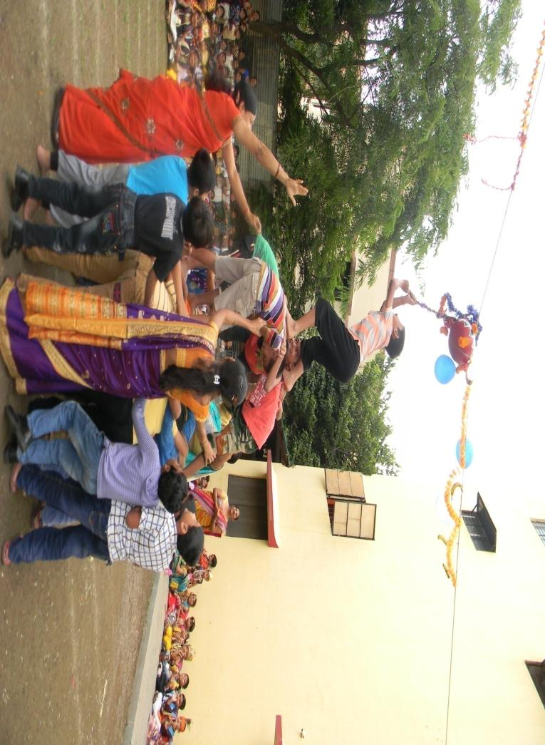

Gopalkala

Slide 45
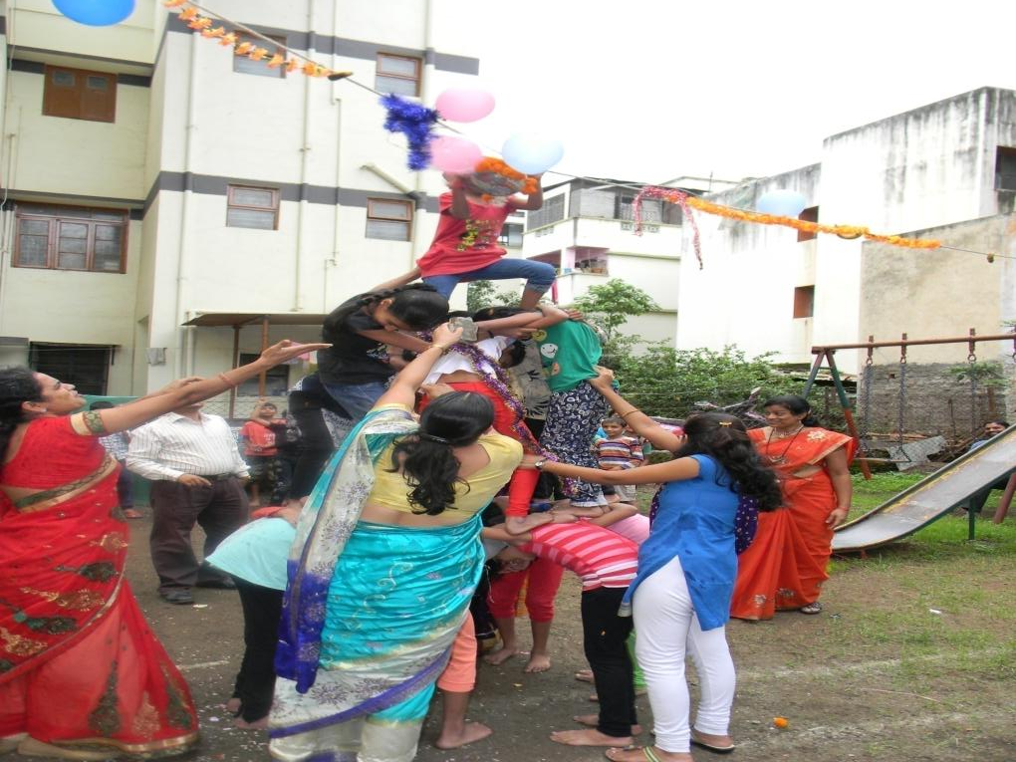
Gopalkala

Slide 46
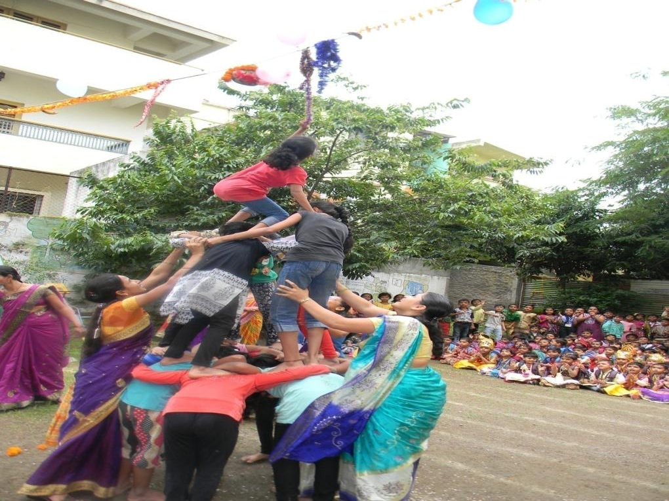
Gopalkala

Slide 47
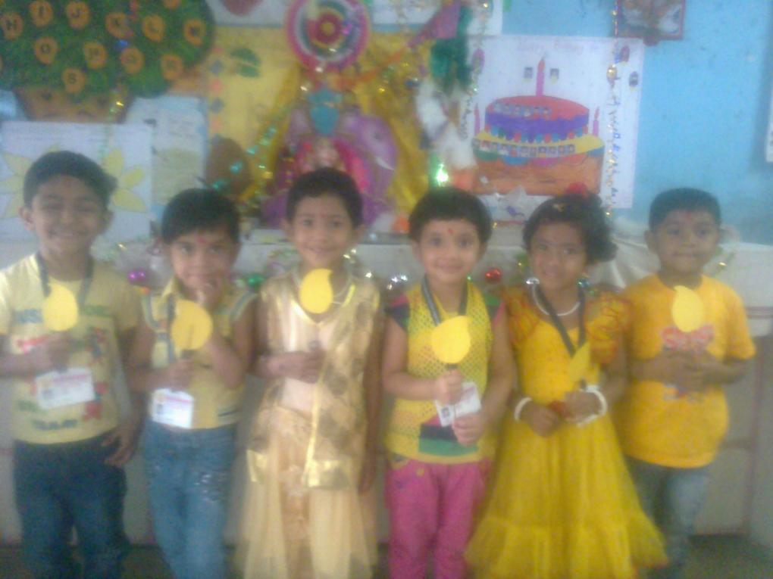
Yellow Day

Slide 48
Yellow Day

Slide 49
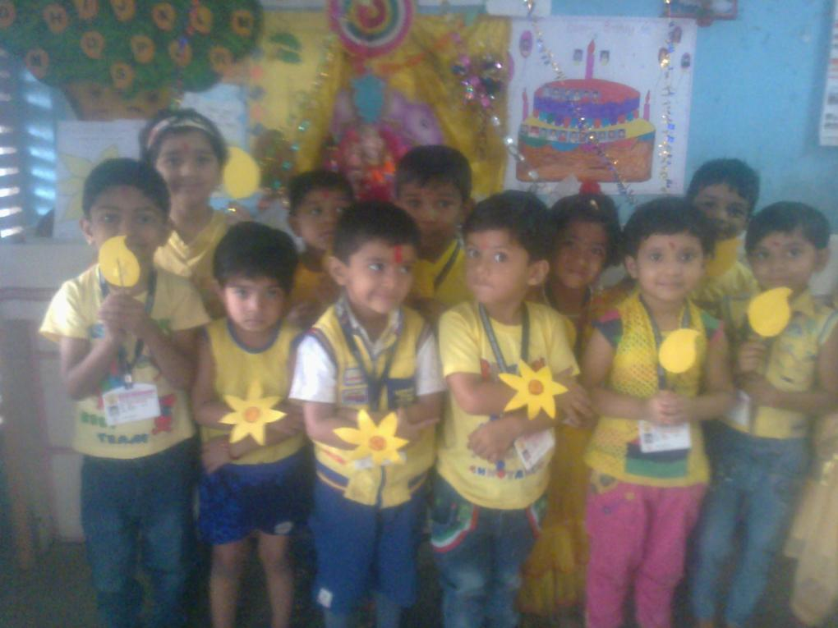
Yellow Day

Slide 50
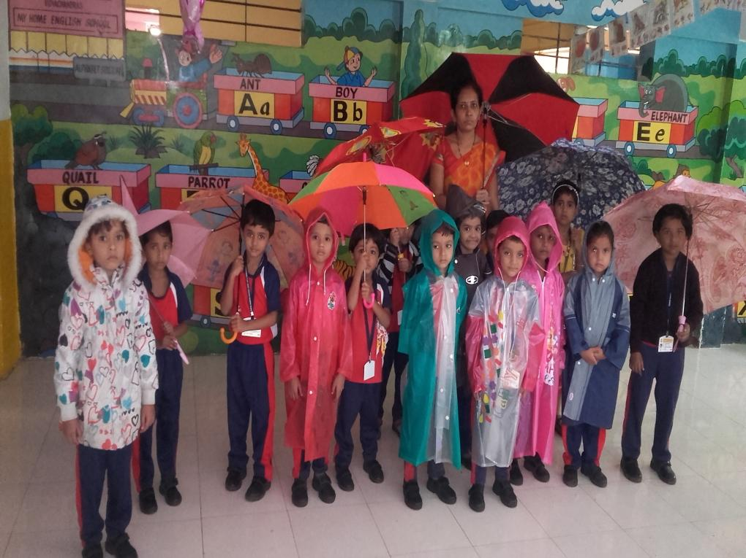
Rain Creature

Slide 51
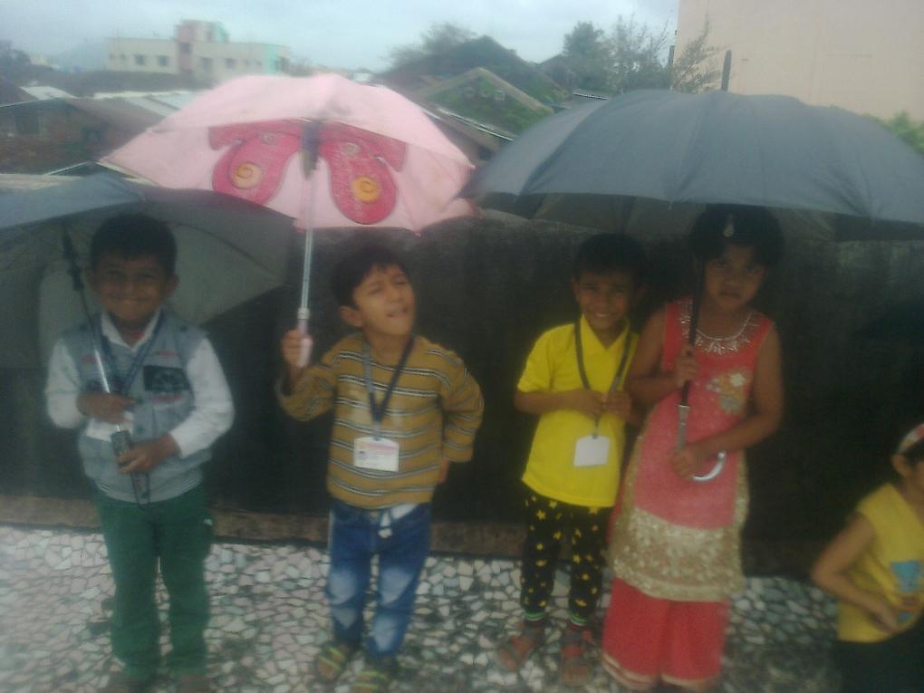
Rain Creature

Slide 52
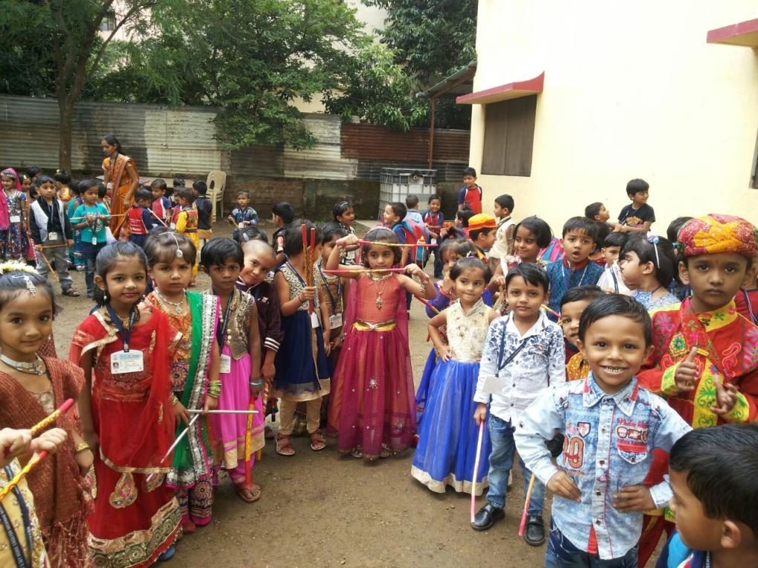
Dandiya

Slide 53
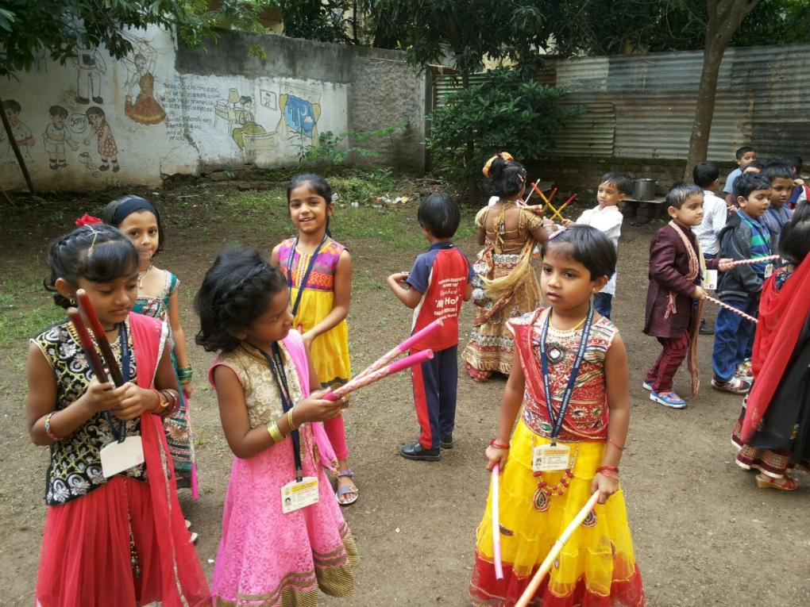
Dandiya

Slide 54
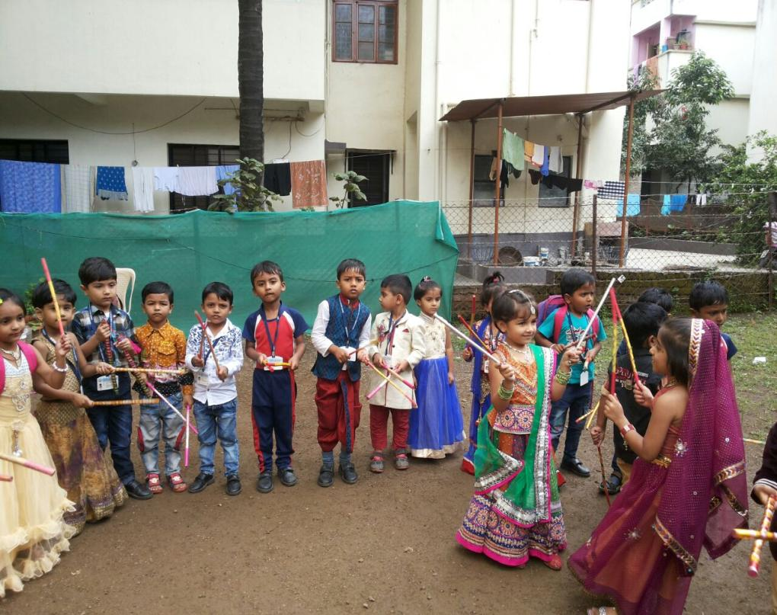
Dandiya

Slide 55
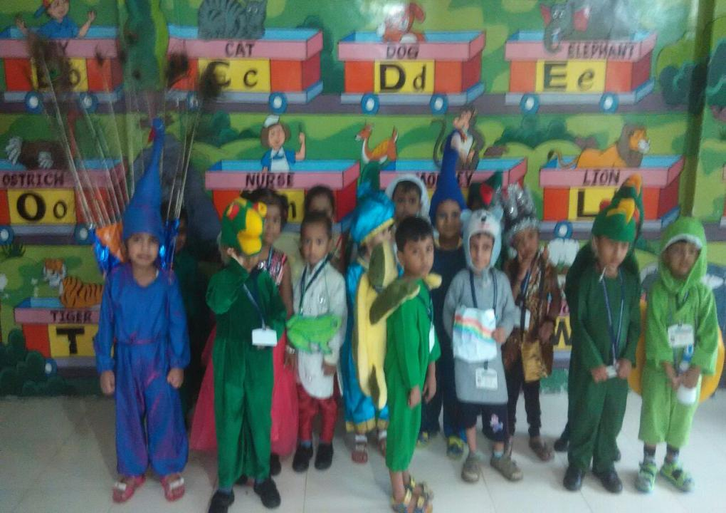
Fancy Dress

Slide 56
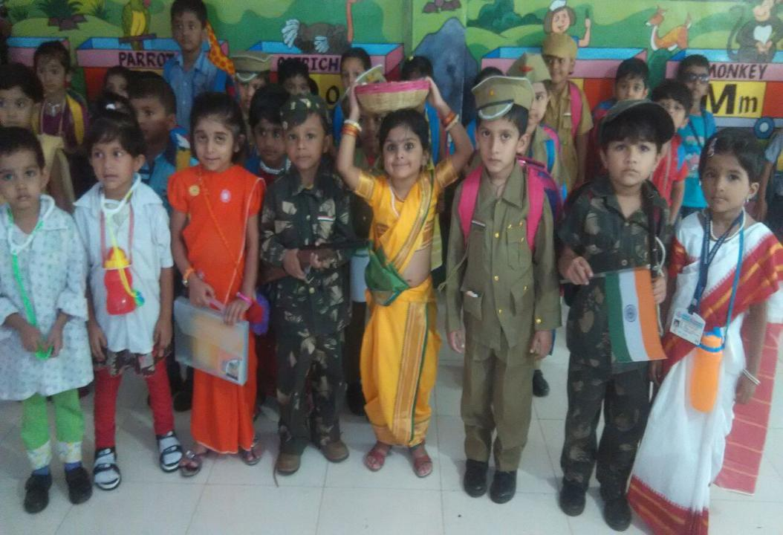
Fancy Dress

Slide 57
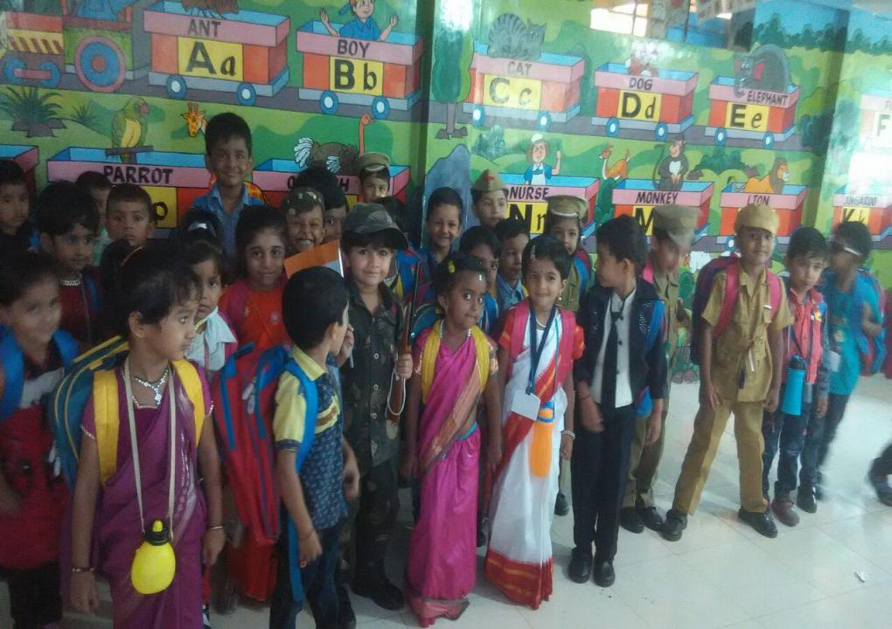
Fancy Dress

Slide 58
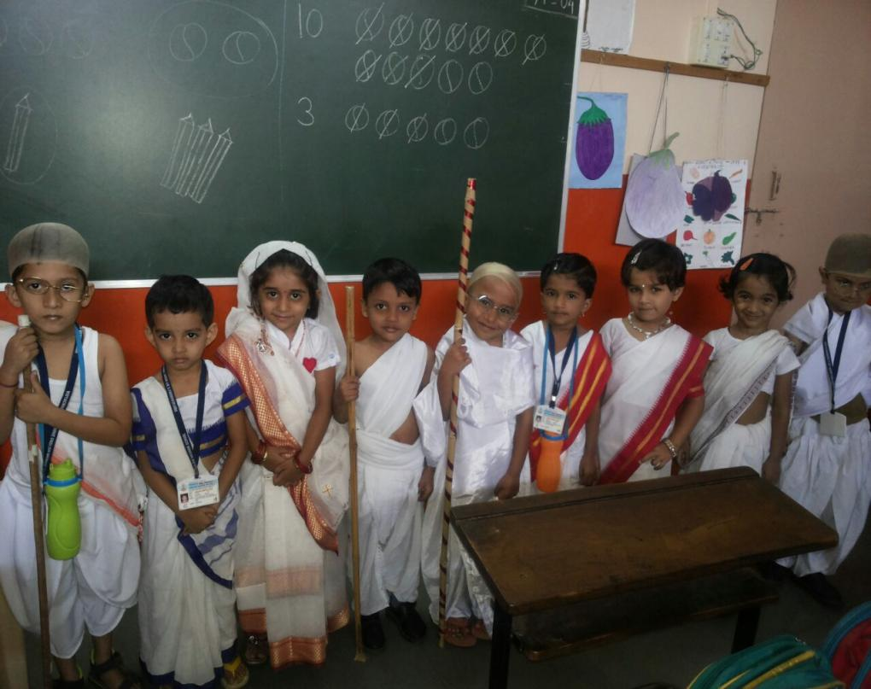
Gandhi Dress up

Slide 59
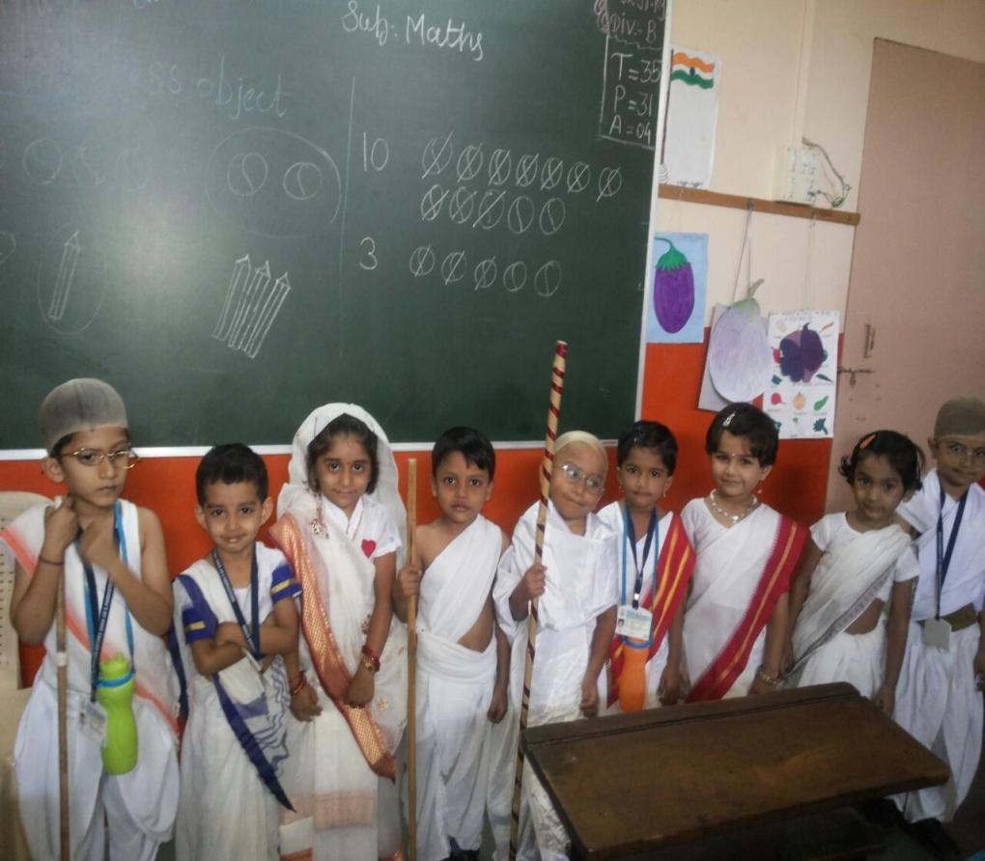
Gandhi Dress up

Slide 60
Gandhi Dress up

Slide 61
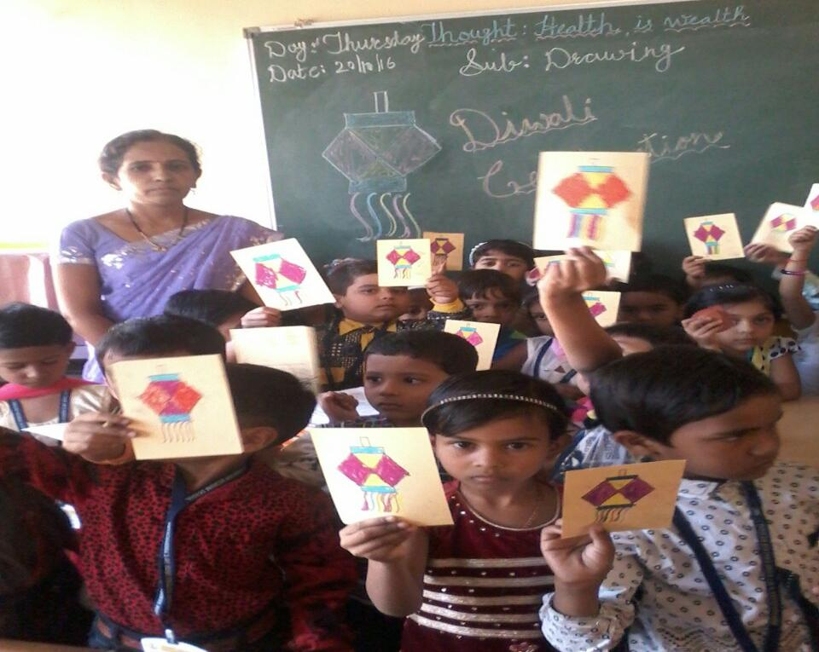
Diwali

Slide 62
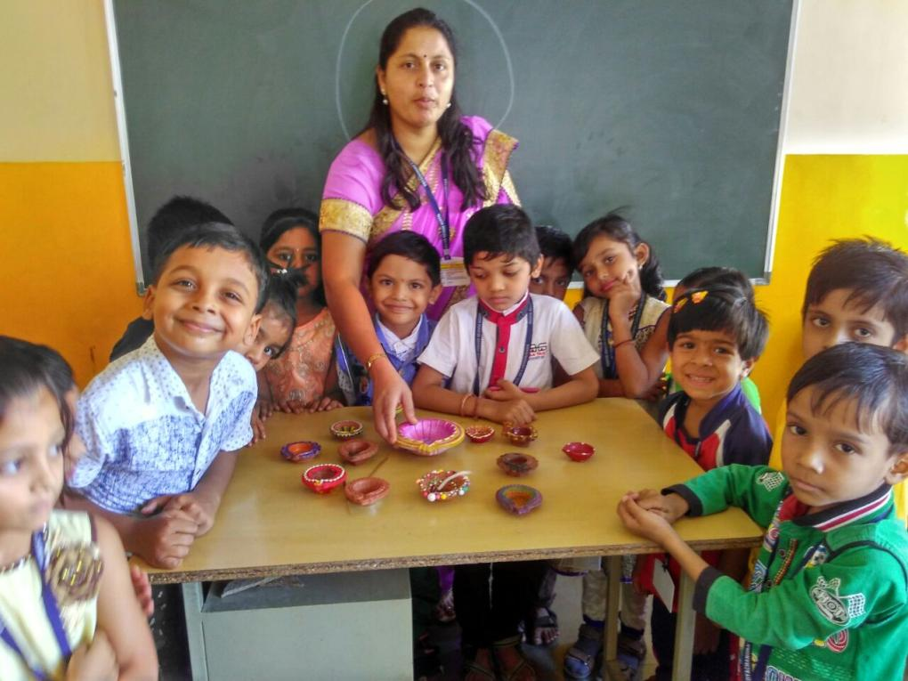
Diwali

Slide 63
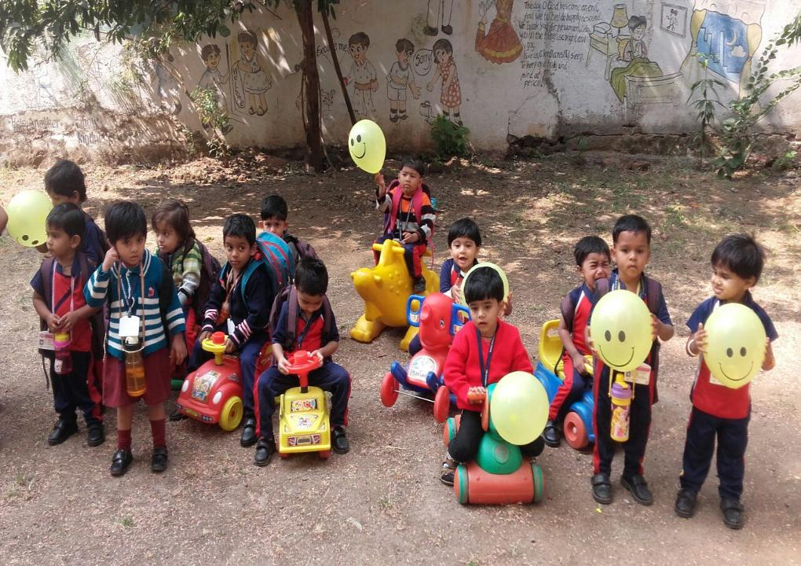
Children’s day

Slide 64
Children’s day

Slide 65

Constitution Day

Slide 66

Constitution Day

Slide 67

PicNic

Slide 68

PicNic

Slide 69

PicNic

Slide 70

PicNic

Slide 71

PicNic

Slide 72

PicNic

Slide 73

PicNic

Slide 74

Computer Department

Slide 75


Slide 76


Slide 77


Slide 78

Computer Department

Slide 79

Sports

Slide 80


Slide 81


Slide 82


Slide 83


Slide 84
Free check up for family on O.P.D basis

Slide 85
Special Request for parents
Responsibility for student.
For studies.
For attendance.
To seat with your child daily for studies.
To daily check school bag.
Prime responsibility for attending open house.

Slide 86
Responsibility of teacher
Education.
Sanskar.
Competition .
Activity.
Punctuality.
Uniform neat & clean.
Tiffin scence.

Slide 87
Exemplary students
Play Group
Dhanishka Ninad Uphade
Paras Manohar Jopale

Slide 88
Exemplary students
Nursery Div-A
1. Ambekar Yash Yogesh
2. Pawar Meghana Zambru

Slide 89
Exemplary students
Nursery Div-B
1. Pehre Yash Rahul
2. Dhakne Arohi Parag

Slide 90
Exemplary students
Jr. Kg.A
1. Zirwal Sahil Sahebrao
2. Gawali RuturajNandkumar

Slide 91
Exemplary students
Jr. Kg.B
Wagh Lavnya Madan
Andhale Nayan Shivaji

Slide 92
Exemplary Students.
Sr. Kg.A
Jayesh Yogesh Bairagi
Anushka Sachin Hire

Slide 93
Exemplary Students.
Sr. Kg.B
Vaidehi Bipin Chorage
Arnav Sachin Jadhav

Slide 94
Exemplary Students.
Std- 1st
1. Chinmay Shailesh Patil
2. Siddhi Amol Nikam

Slide 95
Exemplary Students.
Std- 1^{st -B}
1. Ankirna Rajesh Shah
2. Shourya Anand Jadhav

Slide 96
Exemplary Students.
Std- 2nd
1. Anushka Santosh Jadhav
2. Ayush Vinod shinde

Slide 97
Exemplary Students.
Std-3rd
1. Kishori Uttam Kamdi
2 . Aditya Shashikant Patil

Slide 98
Exemplary Students.
Std- 4th
1. Sahil Bhagwan Khandave.
2. Lekhashree Prakash Nagarkar

Slide 99
Exemplary Students.
Std – 5th
Rajkumar Chandrabhan Jadhav .

Slide 100
Exemplary Students.
Std- 6th
1. Kaveri Rajendra Dhatrak

Slide 101
Exemplary Students.
Std -7th
1. Sudarshan Suresh Jadhav

Slide 102
Nursery- Battase Soham Sachin .
Jr.kg:- Kasture Swara Shyam .
Sr.Kg– Kasbe Prithvi Tanaji .
The Girnare English school
Exemplary Students

Slide 103
Basic Computer Course
Mrs. Savita Vinod Pabale
Mrs.Yogita yogesh Palkhede
Mrs.Madhuri Vinod Khairnar

Slide 104
CAPTAIN OF THE SCHOOL
Ghangale Nikhil
VICE CAPTAIN
Sanap Samrudhi

Slide 105

THANK YOU….

