Slide 1
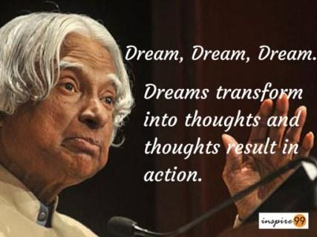

Slide 2


Slide 3

Wel - come

Slide 4

ANNUAL FUNCTION
2015-2016

Slide 5
WELCOME
VIDYACHANDRA EDUCATION AND WELFARE TRUST
VIDYACHANDRA’S “MY HOME”
ENGLISH MEDIUM SCHOOL,
SNEH NAGAR, MHASRUL,
NASHIK – 422004.

Slide 6

WELCOME
Images for flower wallpaper

Slide 7
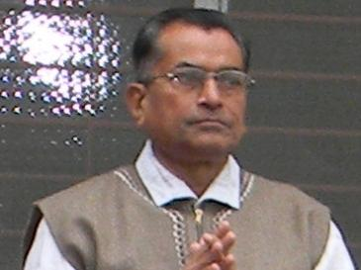
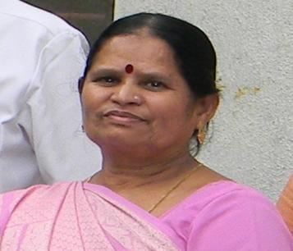
HONOURABLE TRUSTEE
MR. S.P.JAIN-
MRS. V.S.JAIN

Slide 8
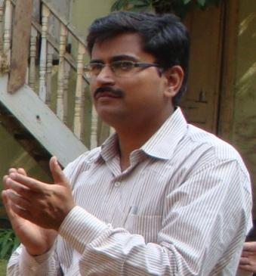
MANAGING DIRECTOR
DR.VIRENDRA JAIN
M.D.

Slide 9
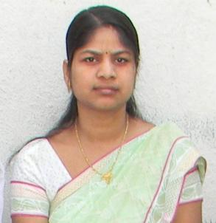
OUR PRINCIPAL
DR.ARTI V. JAIN
B.A.M.S. DSM.

Slide 10
STARTED WITH PRI-PRIMARY IN YEAR 2006.
We started with 22 students & today we have 350 + students

Slide 11
We are Gov.Recognised. state board C.B.S.E pattern school
The school to reach std 10th as per natural growth.

Slide 12
Next year admission open for playgroup to std. 8th

Slide 13
Our specialty 30 students per class with aim for tuition free education.
Concept understanding.

Slide 14
SPECIAL ACTIVITY IN OUR SCHOOL
Extra classes
Special coaching with question bank
News Paper Reading
Indoor games- Chess Carom
Outdoor games-Throw ball, track events, badminton.
Cooking Activity
Skating
English speaking class
Library Facility (800 Books)
Environmental Care.
Hypnotism; Meditation.
Karate.
Medical check up(All time doctor present ladies & gents. )

Slide 15
Audio-visual Library.
Personality Development.
Quiz Session. Every Saturday.
Social Responsibility.
Yoga section.
Music, tabla harmonium, dance.
Annual Function.

Slide 16
CELEBRATIONS
Independence Day
Gokul ashtami
Teacher’s Day
Ganesh chaturthi
Navratri dandia
Gandhi Jayanti
Diwali Celebration
Rakshabandhan

Slide 17
ACTIVITIES
Green day ,Red day, White day, Yellow day
Vegetable pared & fruit pared
Chart making
Rakhi making & sticiking compition
Flag colouring compition
Ruturang day
Greeting making
Radha Krishna dress up compition
Fancy dress –Rain creature , our helper, Great leader
Toy day, Plantation, Raod safety day
Gandhi dress up compition
Diya making

Slide 18
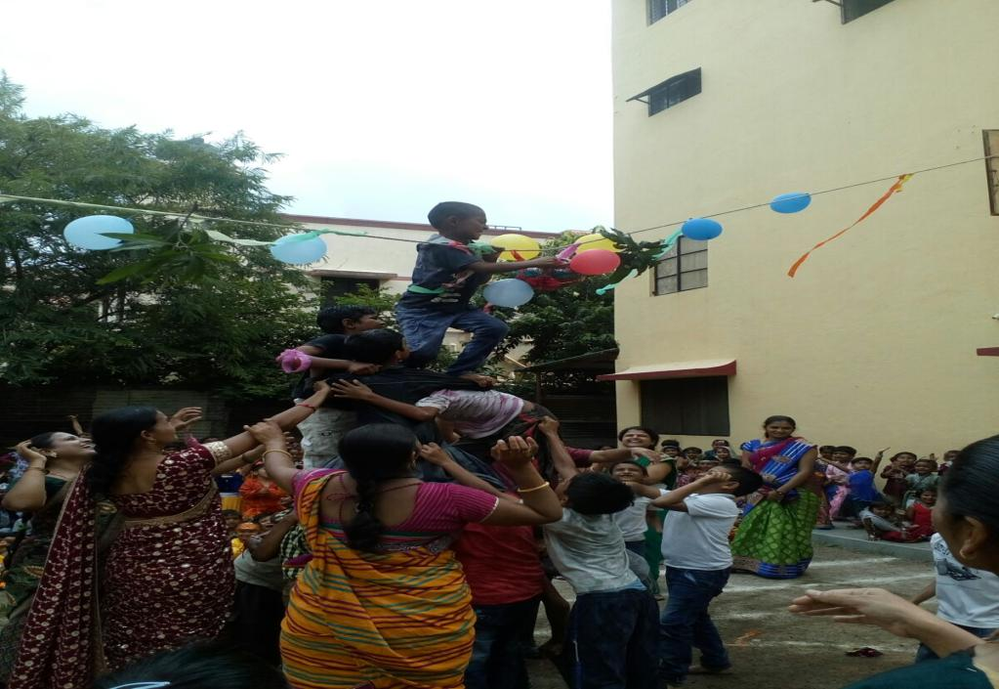

Slide 19
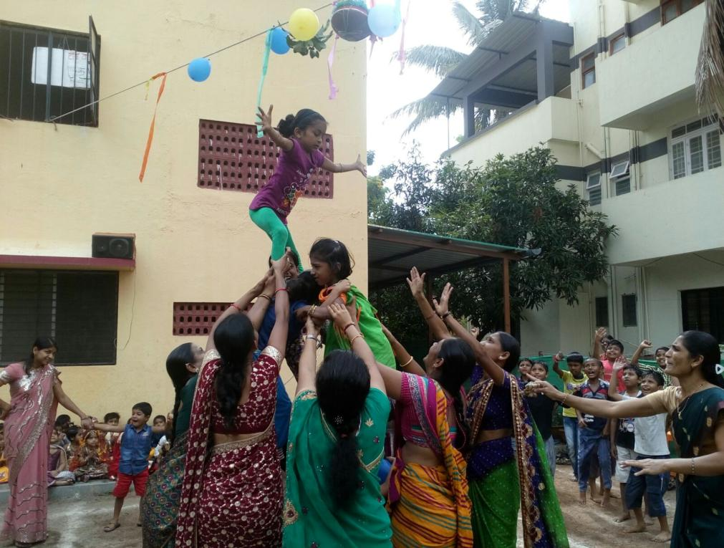

Slide 20
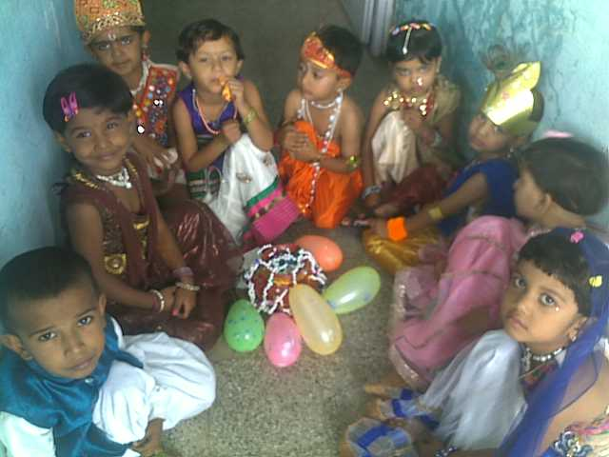

Slide 21
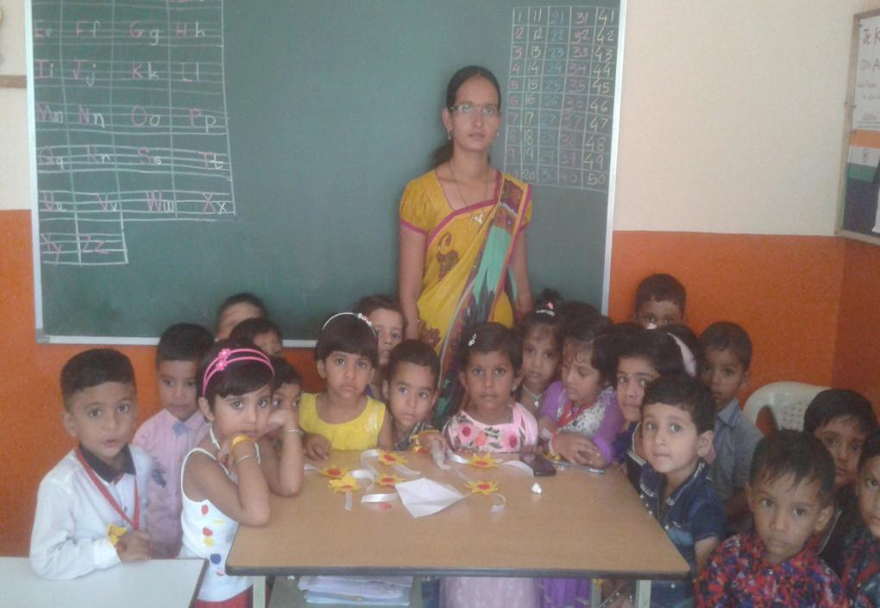

Slide 22
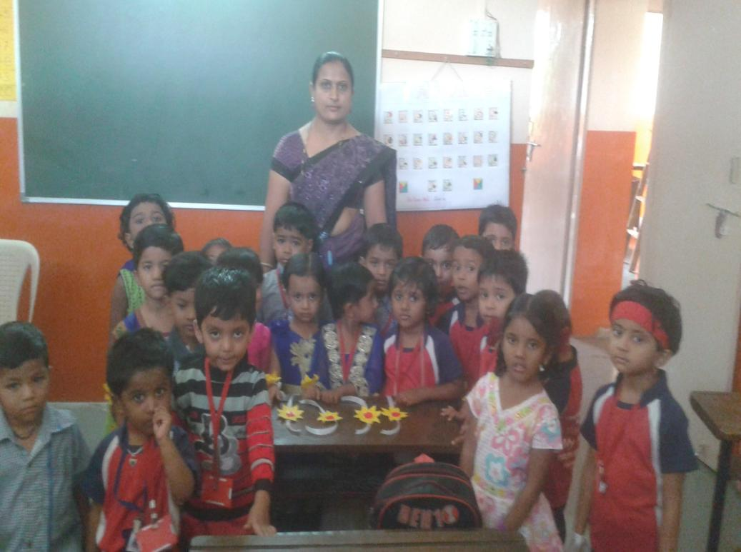

Slide 23
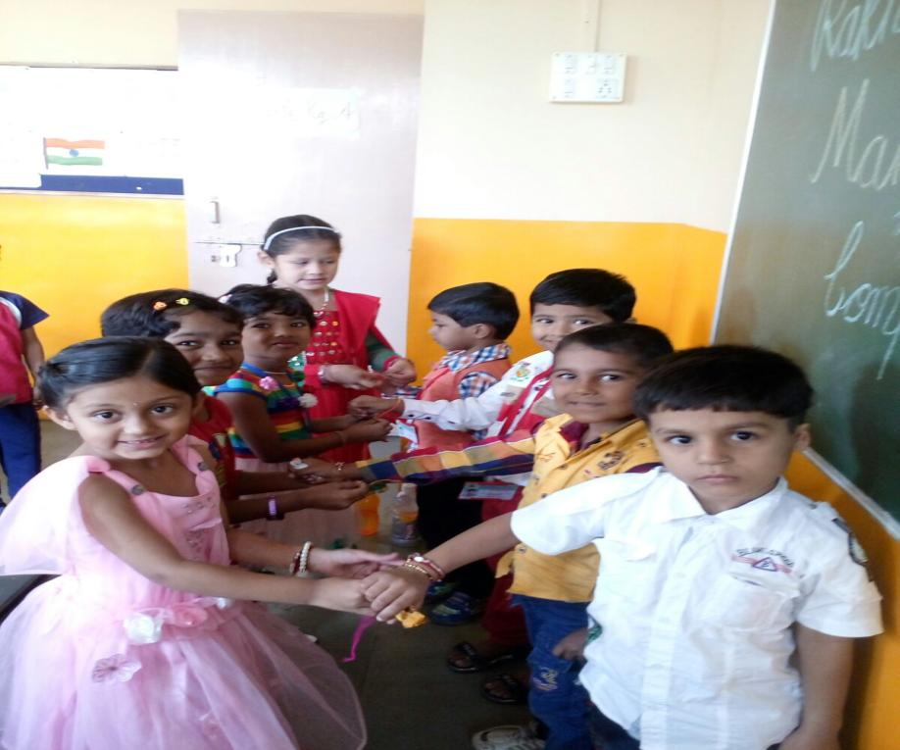

Slide 24
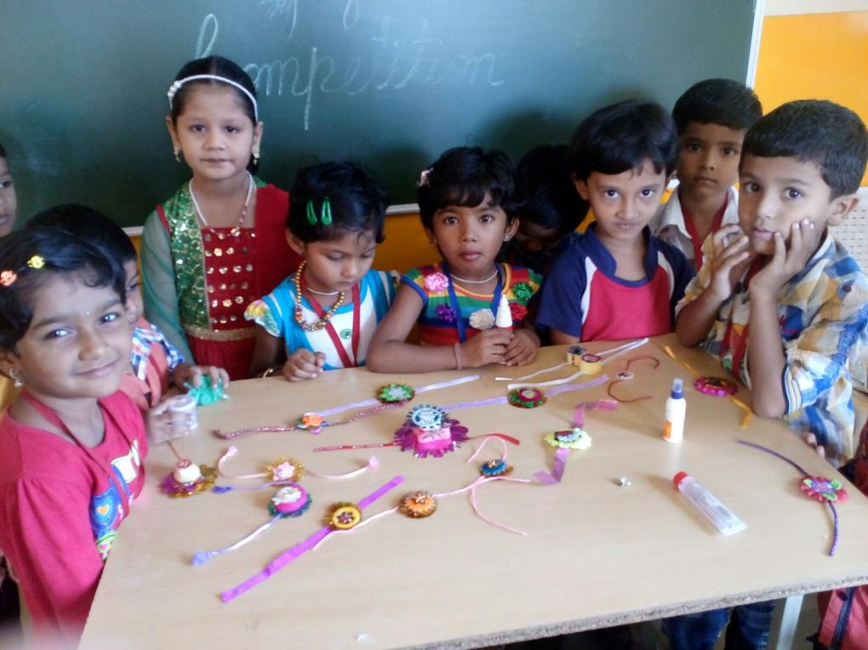

Slide 25
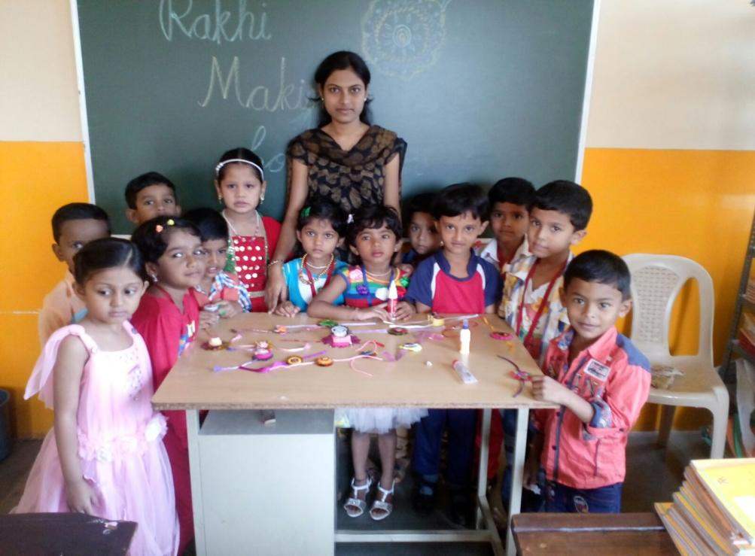

Slide 26
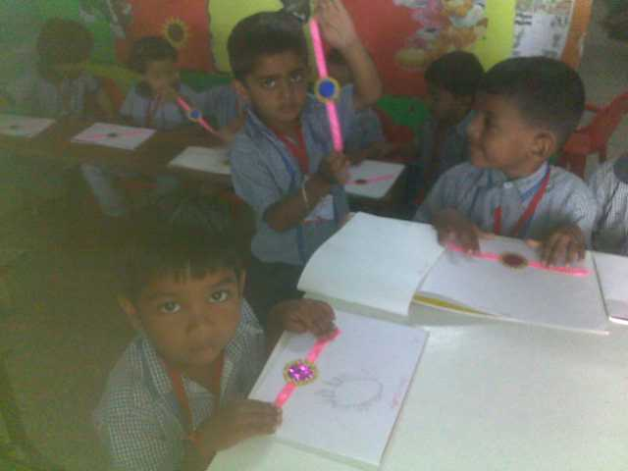

Slide 28
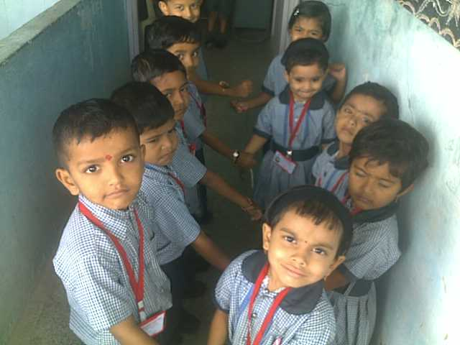

Slide 29
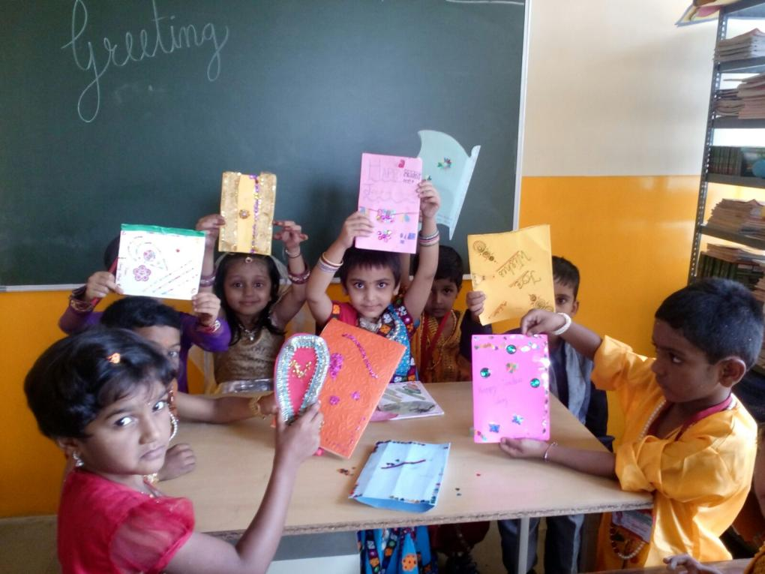

Slide 30
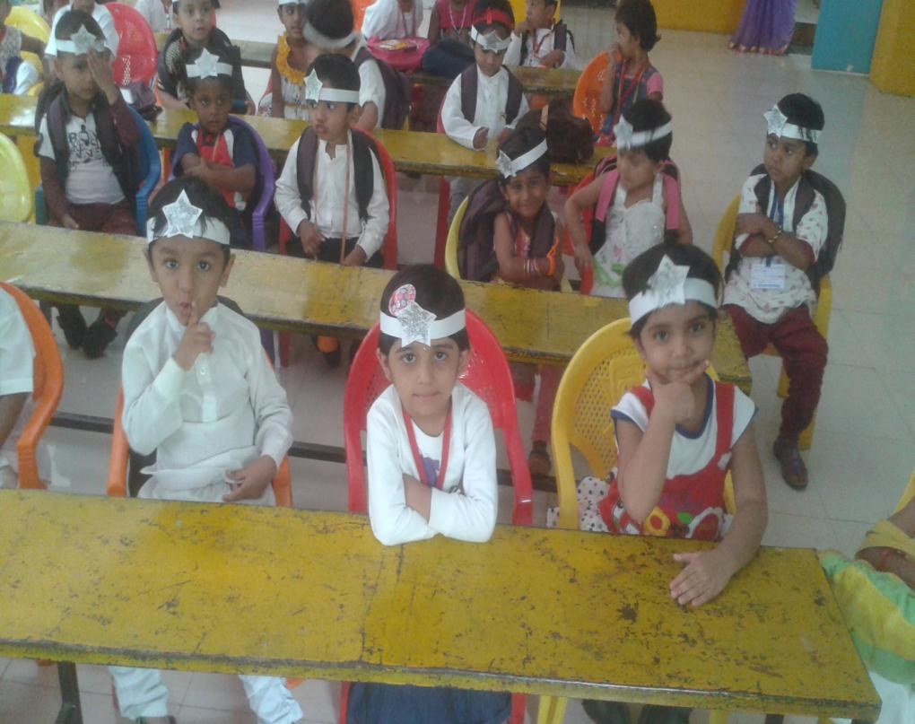

Slide 31
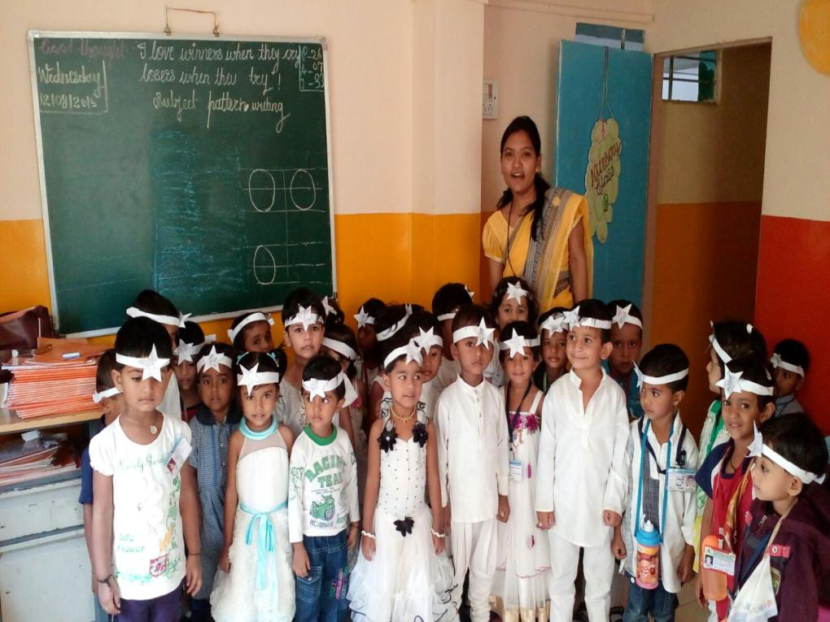

Slide 32
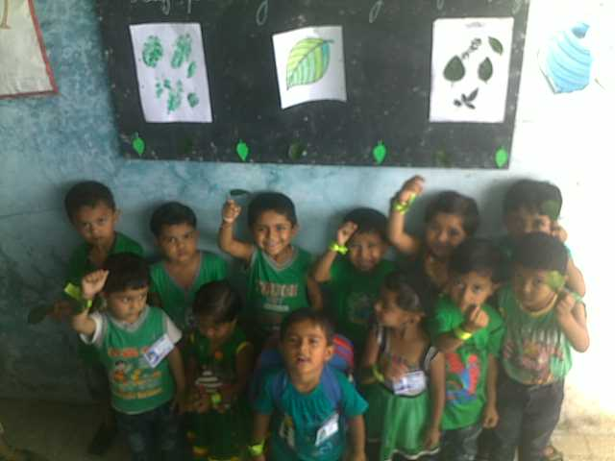

Slide 33
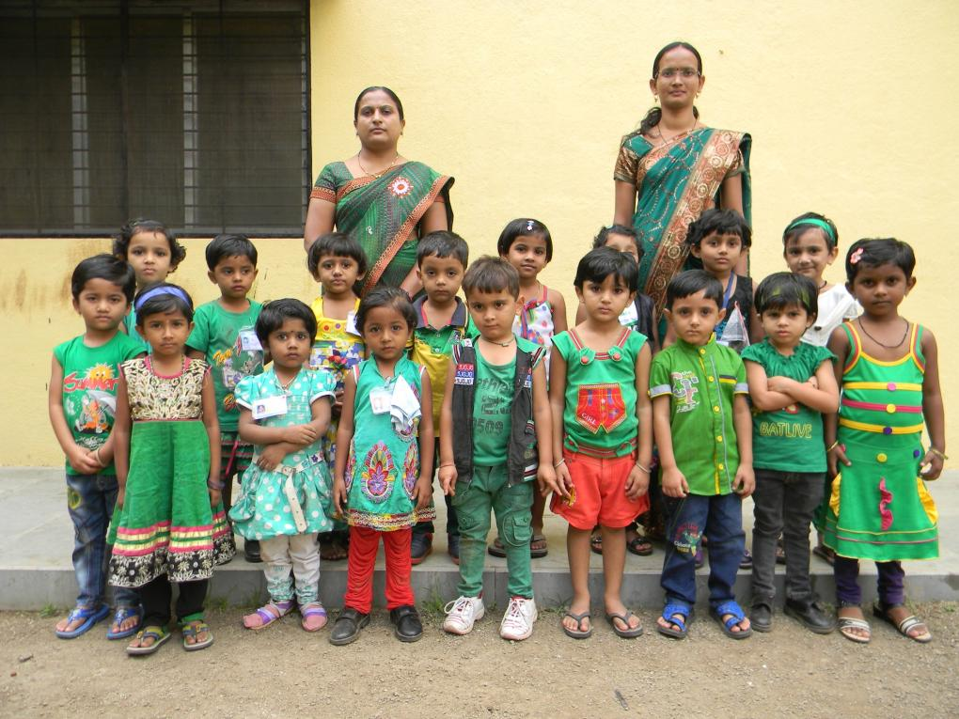

Slide 34
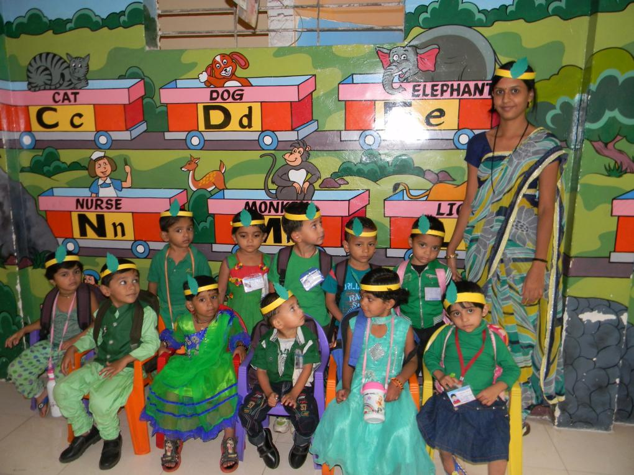

Slide 35
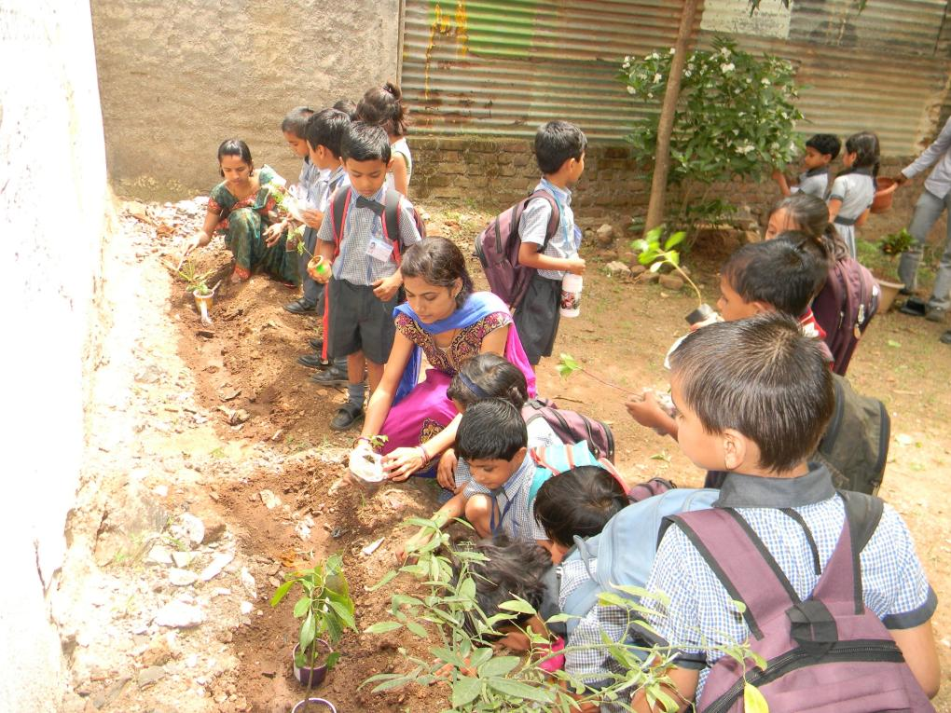

Slide 36
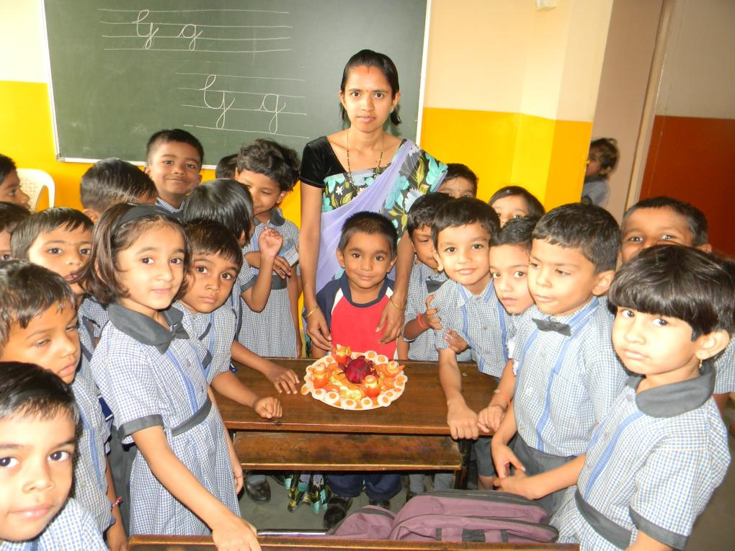

Slide 37
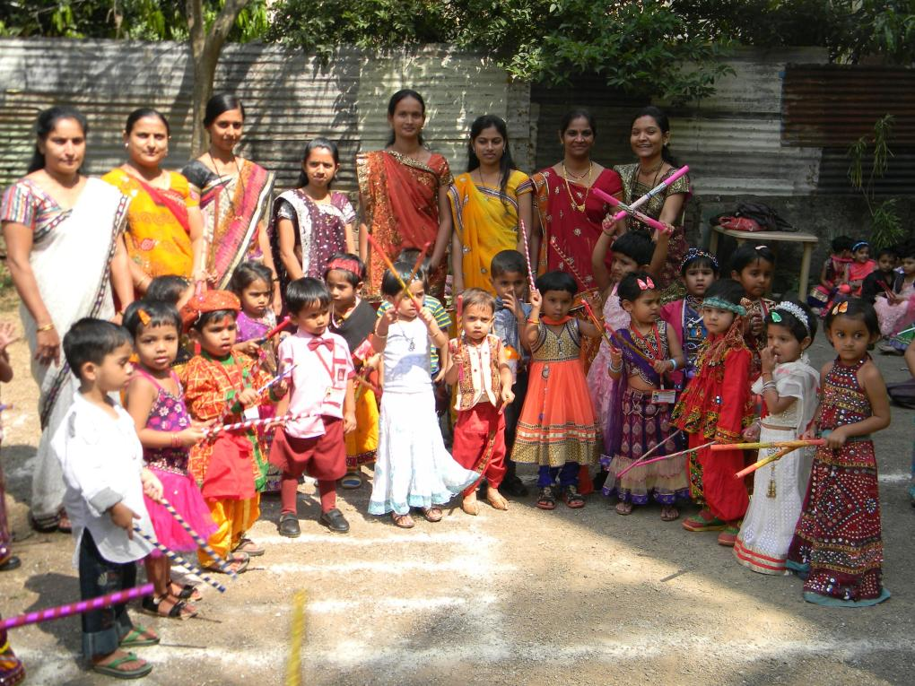

Slide 38
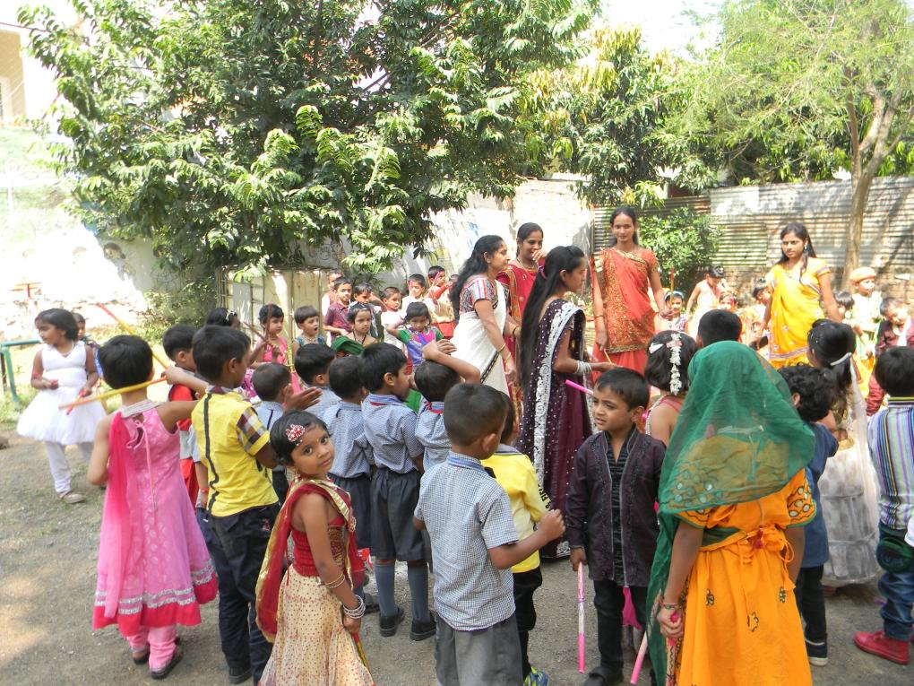

Slide 39
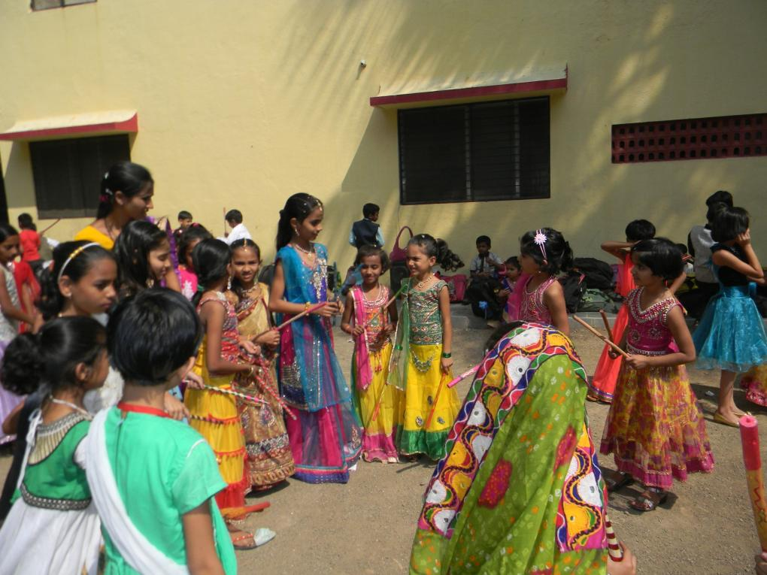

Slide 40
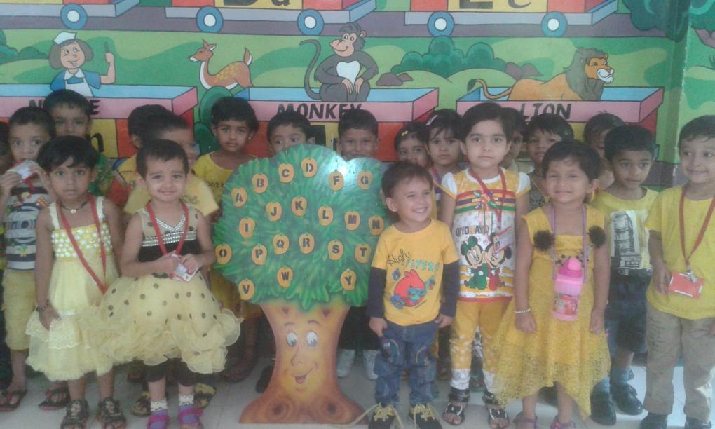

Slide 41
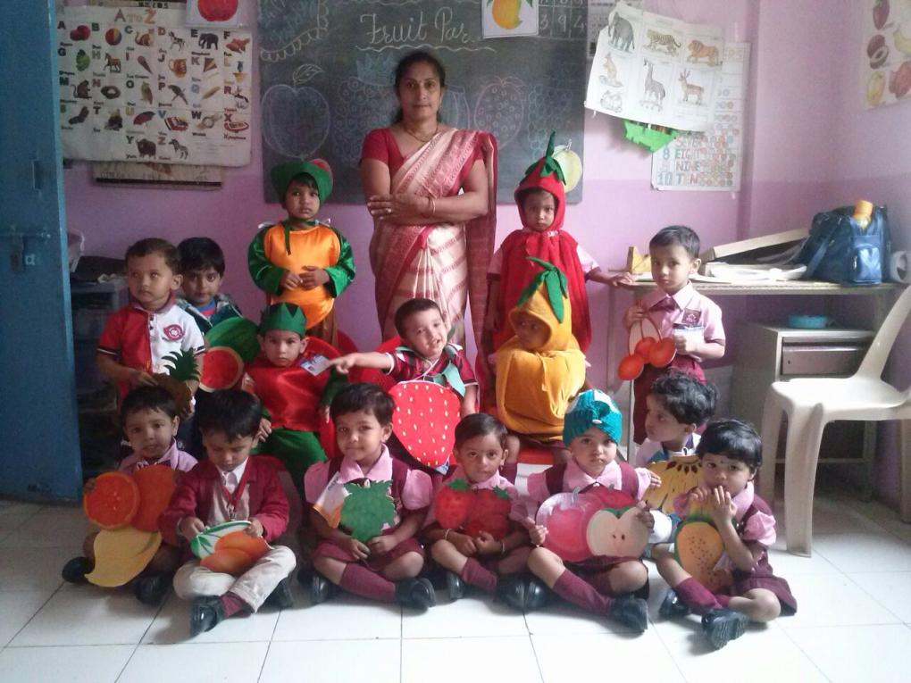

Slide 42
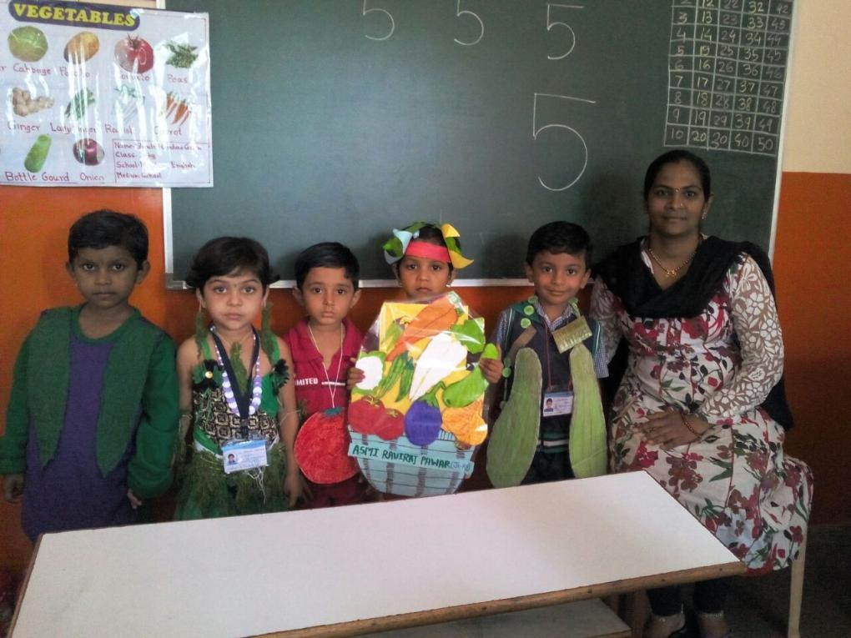

Slide 43
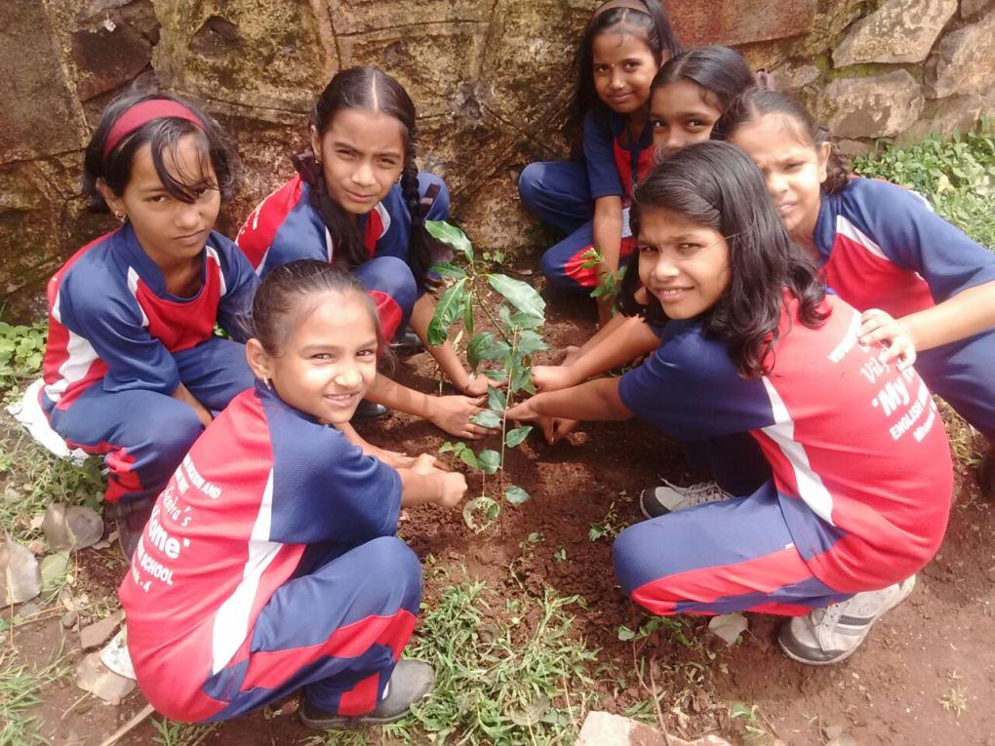

Slide 44
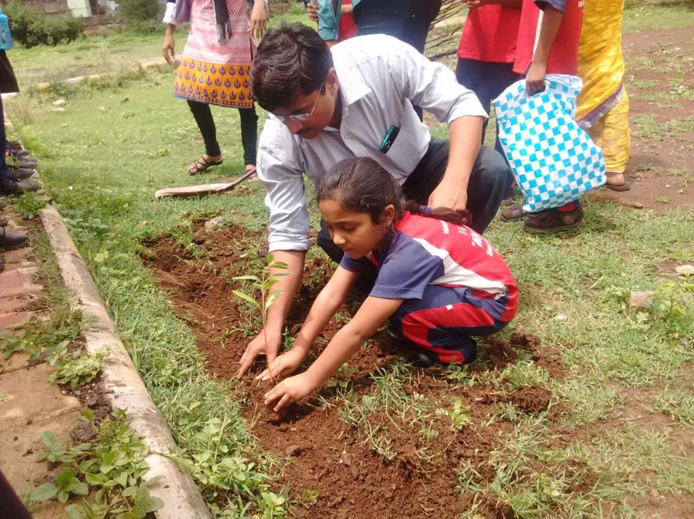

Slide 45
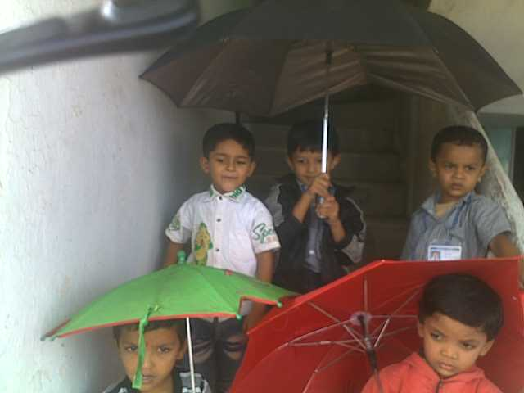

Slide 46
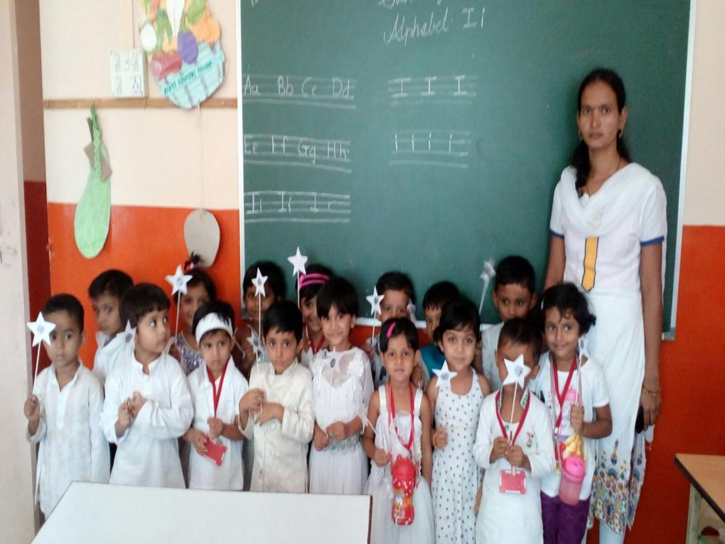

Slide 47
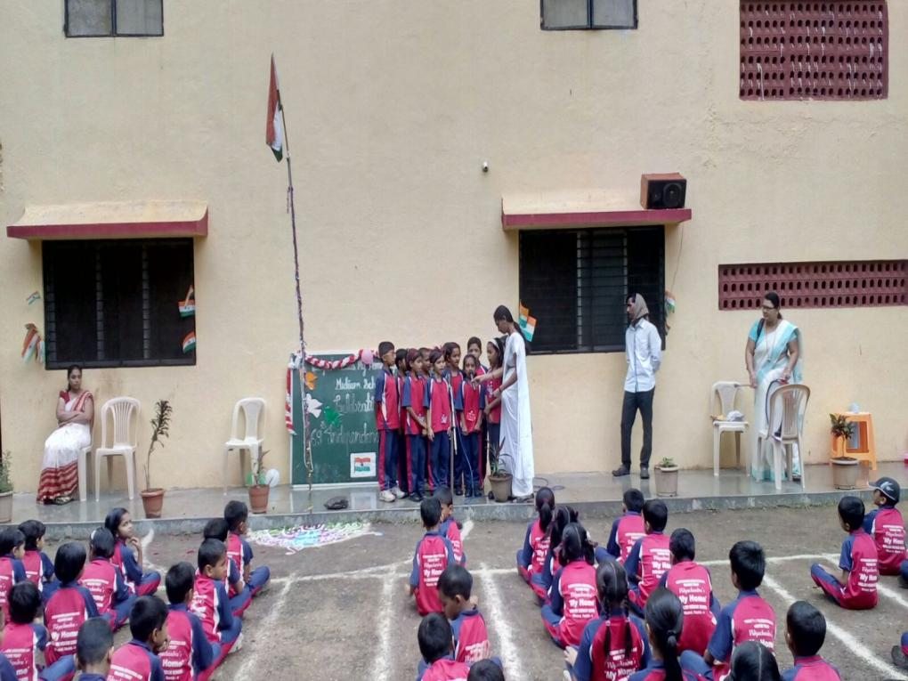

Slide 48
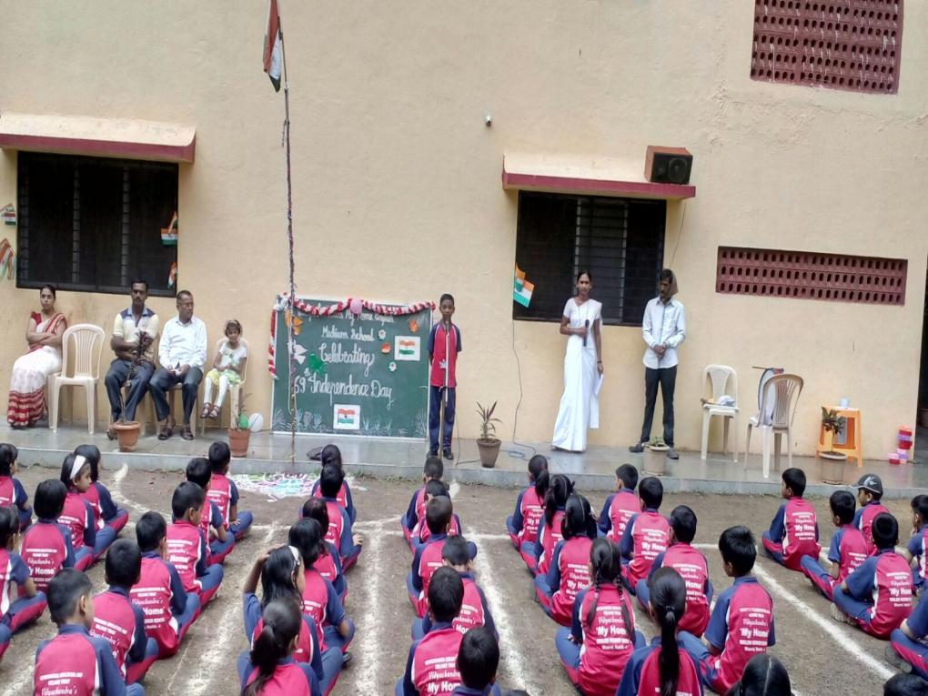

Slide 49
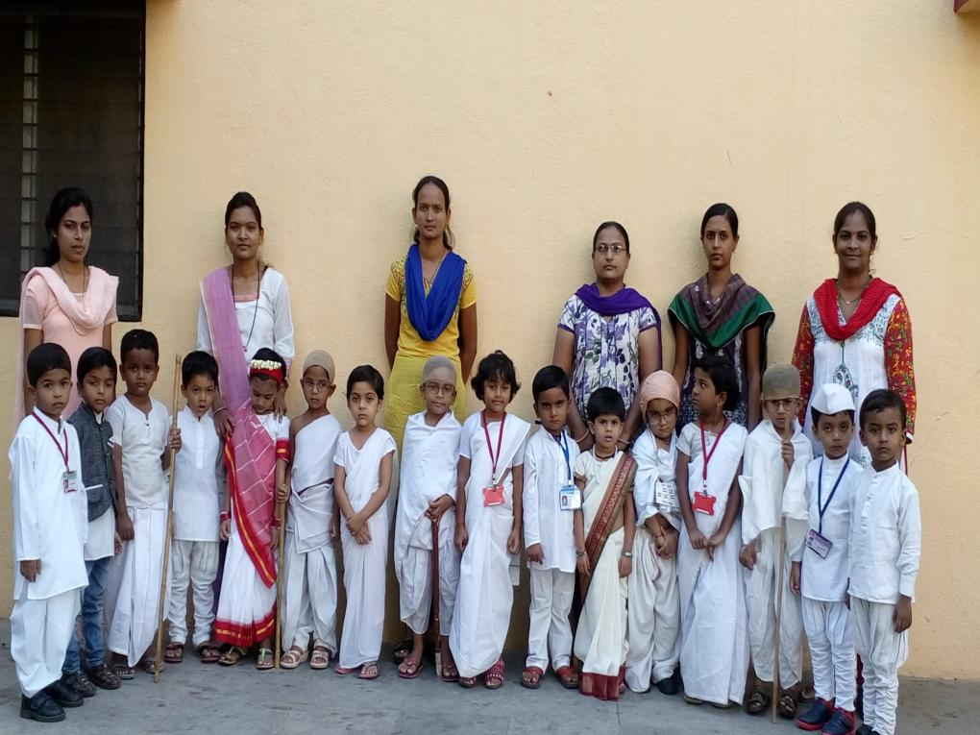

Slide 50
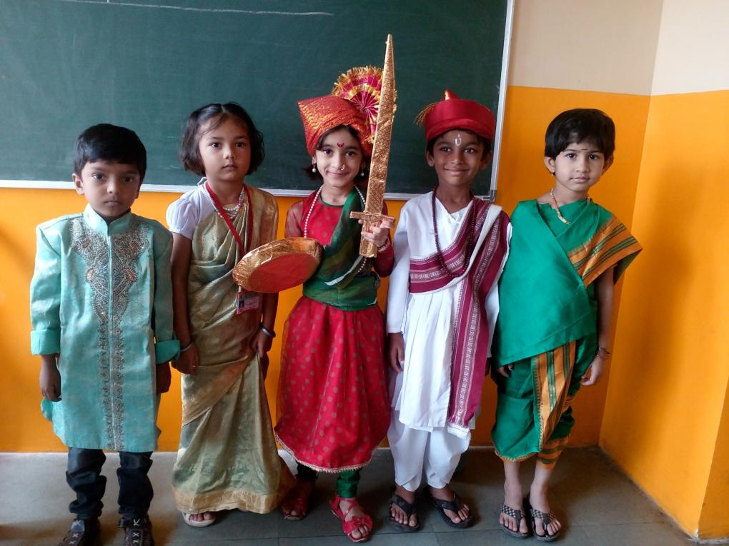

Slide 51
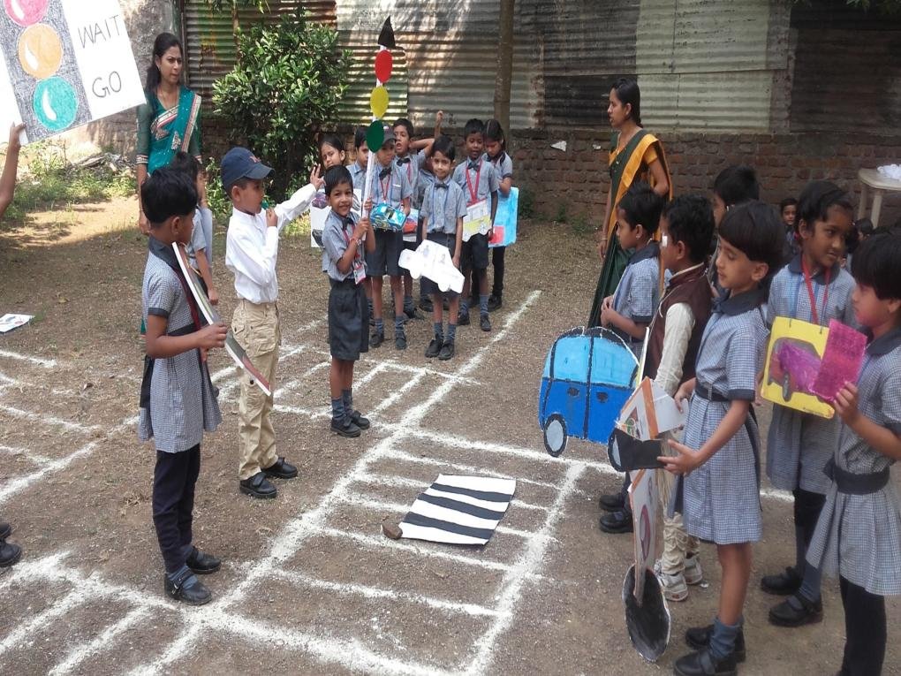

Slide 52
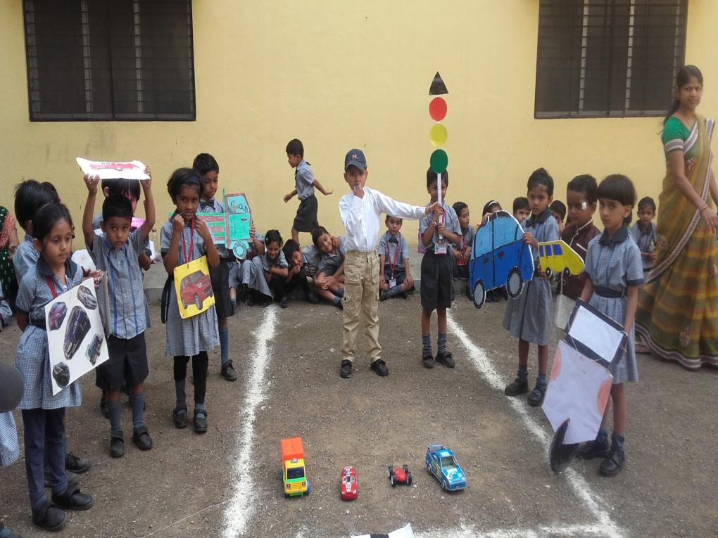

Slide 53
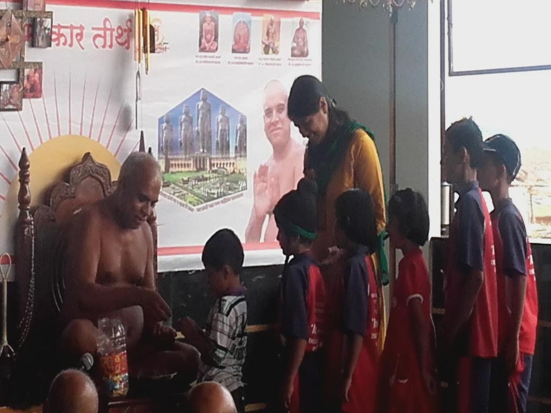

Slide 54
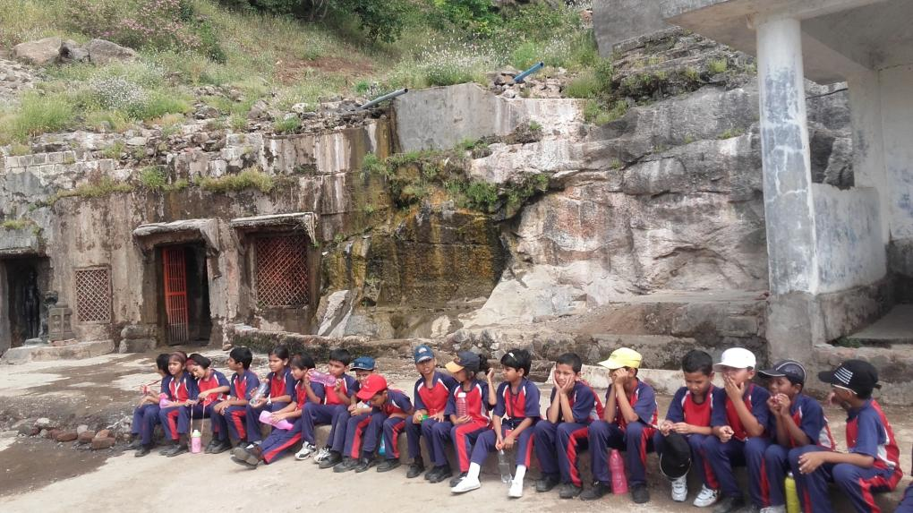

Slide 55
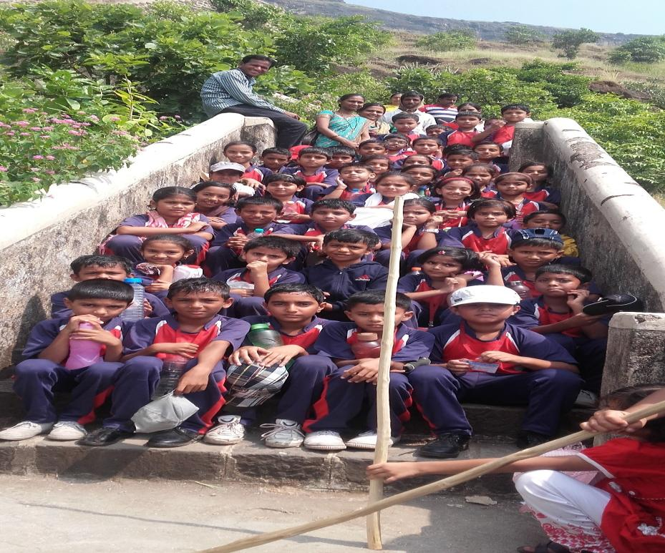

Slide 56
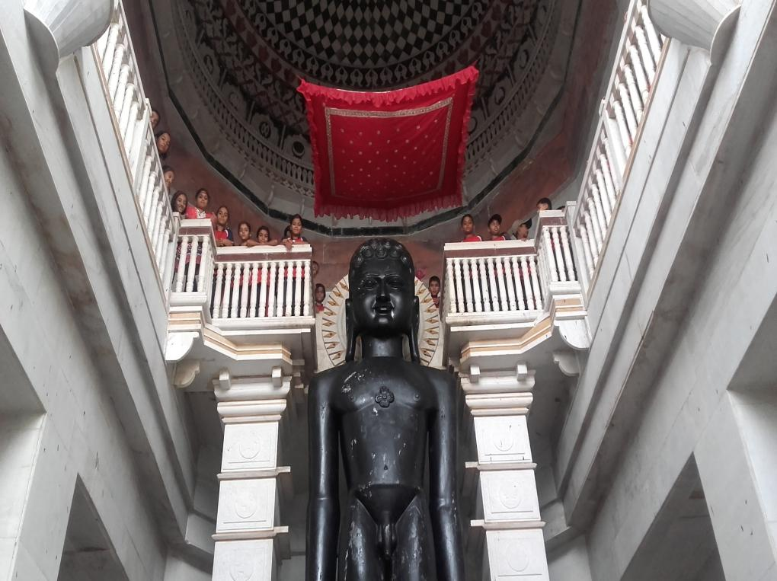

Slide 57
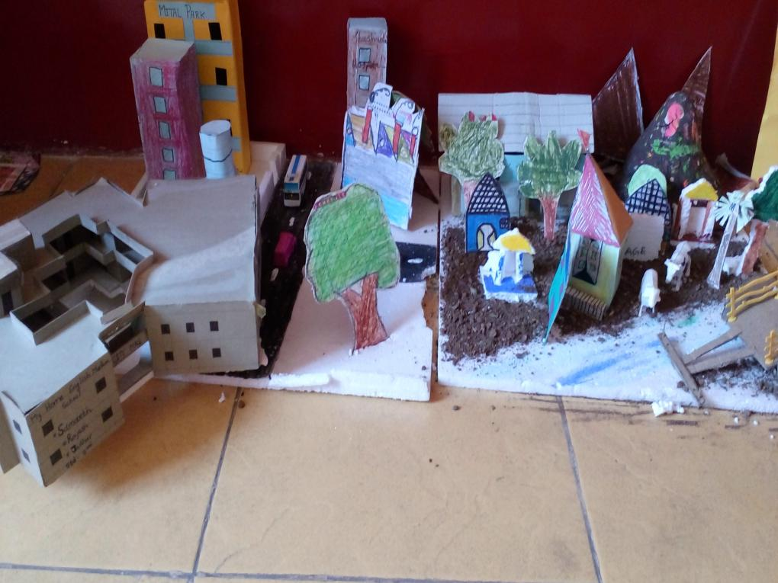

Slide 58
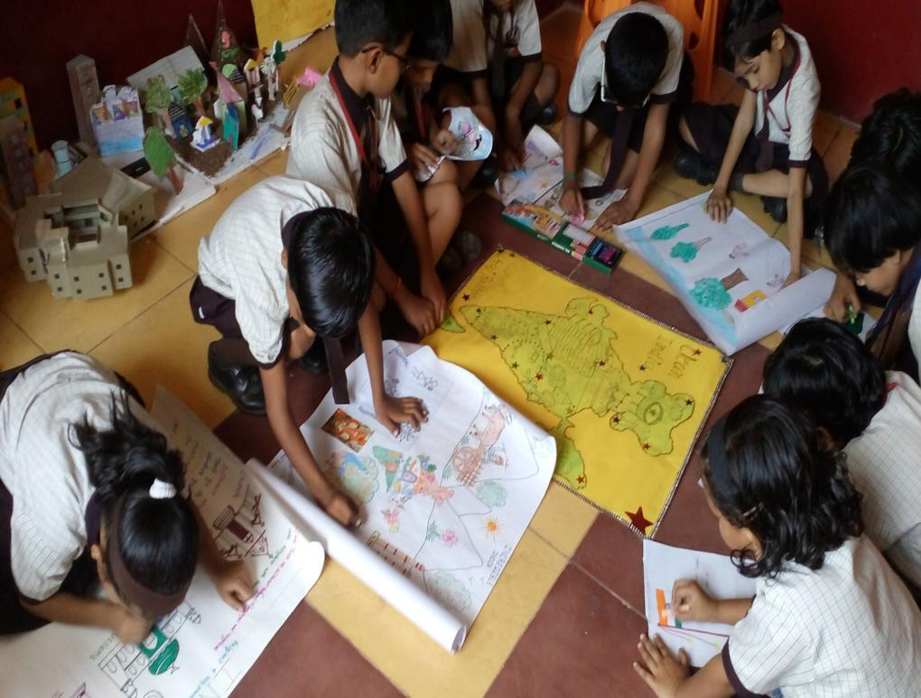

Slide 59
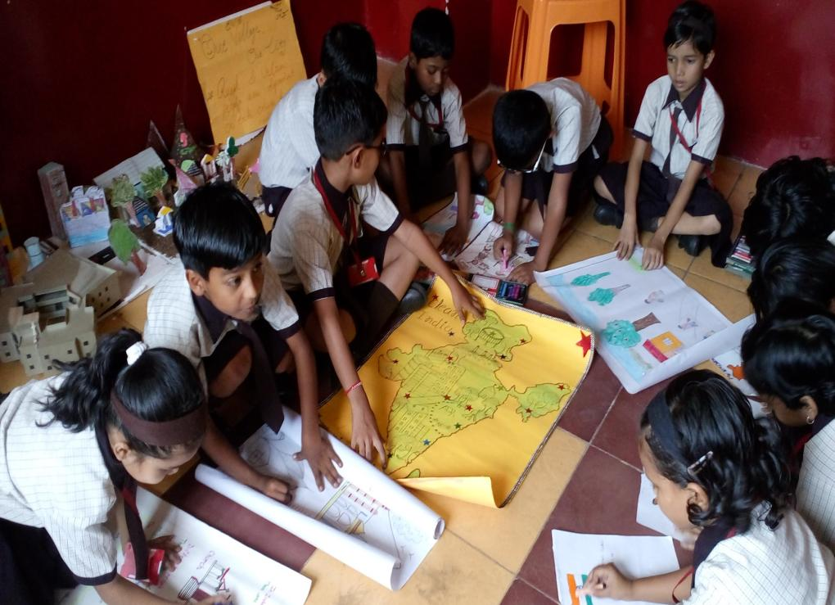

Slide 60
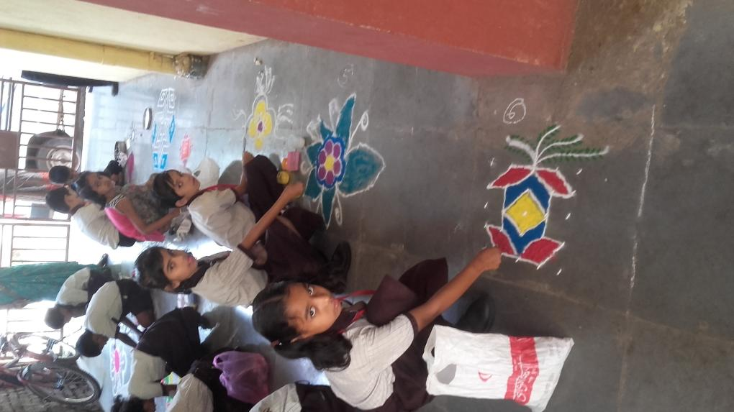

Slide 61
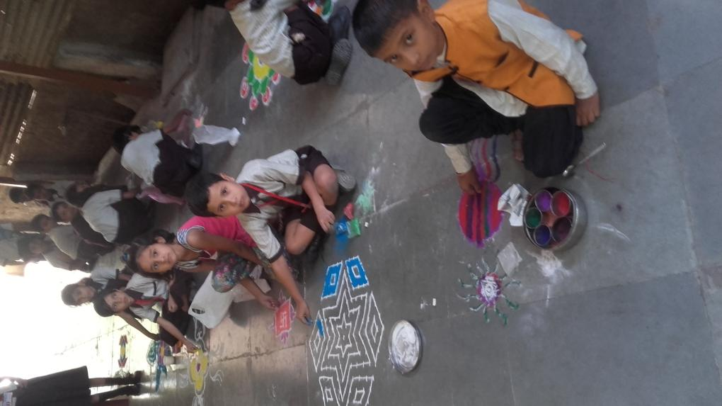

Slide 62
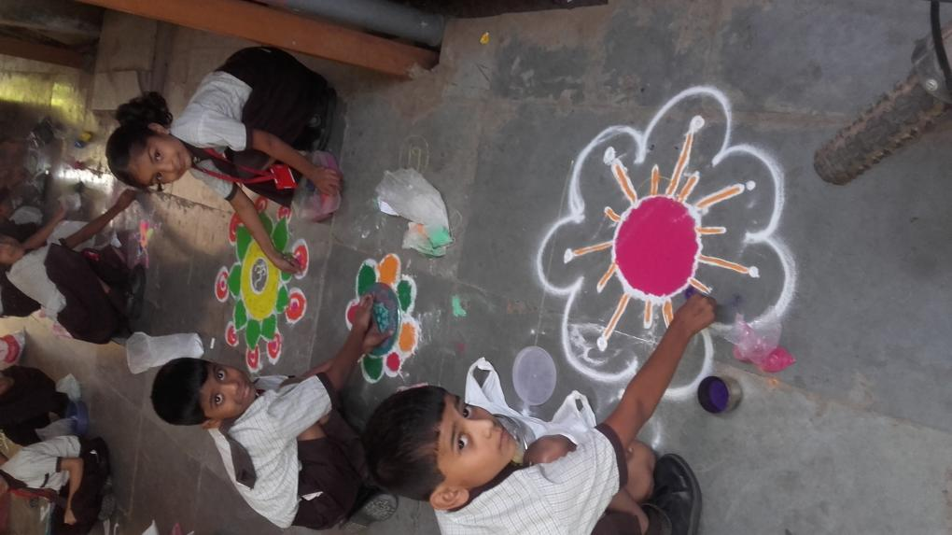

Slide 63
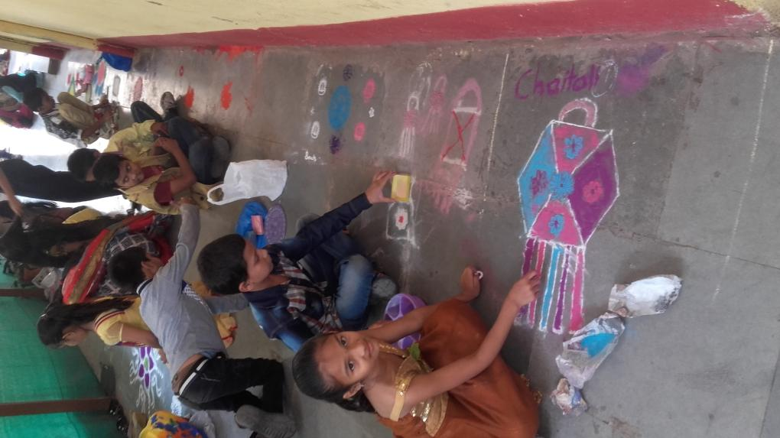

Slide 64


Slide 65


Slide 66


Slide 67


Slide 68


Slide 69


Slide 70


Slide 71


Slide 72


Slide 73

Spots

Slide 74


Slide 75


Slide 76


Slide 77


Slide 78


Slide 79


Slide 80


Slide 81


Slide 82


Slide 83


Slide 84


Slide 85


Slide 86


Slide 87


Slide 88


Slide 89


Slide 90


Slide 91

Medical check up of students.

Slide 92
Free check up for family on O.P.D basis

Slide 93
Special Request for parents
Responsibility for student.
For studies.
For attendance.
For seat with your child daily for studies.
For daily check school bag.
Prime responcibility for attending open house.

Slide 94
Responsibility of teacher
Education.
Sanskar.
Competition .
Activity.
Punctuality.
Uniform neat & clean.
Tiffin scence.

Slide 95
Exemplary students Play Group
Nominated Students
1 Ambekar Yash Yogesh.
2 Baviskar Madhukar M.
3 Dindorkar Kabir.
4 Gaikwad Sanvi Sunil.
5 Lohite Janhvi M.
Selected Students.
1 Baviskar Madhukar M.
2Gaikwad Sanvi Sunil.

Slide 96
Exemplary Student Nursery Div A
Nominated Student
1 Bansode Avantika. 1 Bombale Shree.
2 Gawali Rutuja. 2 Chikhale Aryan.
3Wagh Lavanya. 3 Kulkarni Mihir.
Selected students.
1 Gawali Rutuja.
2 Chikhale Aryan.

Slide 97
Exemplary Student NurseryDiv B
Nominated Students
1 Rutuja Gavli. 4 Nayan Aandhale
2 Bhavna Chaudhari. 5 JatinKarnam. 3Pradnya Jadhav. 6 Aryan Bodke
Selected students.
1 Rutuja Gavali.
2 Jatin Karnam
.

Slide 98
Exemplary Student Jr. K.g.A
Nominated Students.
1 Hire Anushka. 4 Kapure Jay.
2 Gangurde Shruti. 5 TopaleDaksh.
3 Pawat Asmi. 6 GhangaleChetan
Selected students.
1Gangurde Shruti.
2Ghangale Chetan

Slide 99
Exemplary Student
Jr. K.g.B
Nominated Students
1Ahire Tanushaka 4Patial Om
2Lavhat Dhanashri 5Surver Await
3Gawali Vishnavi 6GhetiyMantra
Seletcted Studends
1 Lavhat Danashri
2 Patil Om

Slide 100
Exemplary Students Sr.Kg A
Nominated Students.
1 Ahire Bhavesh 4ChaudhariDimple
2 Gavit Mauur 5Nikam Siddhi
3 Borse Kushal 6 Ighe Sharvari
Selected Students.
1 Gavit Mayur
2 Chaudhari Dimple

Slide 101
Exemplary Student Sr.Kg B
Nominated Students.
1Chinmay Patil 4Siddhi More 2 Tanamy Pawar 5Nirmiti Badgujar
3 Sai Jagtap 6 Harshada Nikam
Selected Students.
1 Tanmay Pawar
2 Siddhi More

Slide 102
The Girnare English school
Nursery- Tidem Anushtha
Jr.kg:- Sangapal Sai
Sr.Kg –Swami Shirsath

Slide 103
Exemplary Student std.1st .
Nominated Students.
1 Thorat Sahil. 1 Jadhav Anushka.
2Sangapal Aditya. 2 Pawar Anvi.
3 Shinde Ayush. 3 Jain Princee.
Selected Students.
1 Shinde Ayush
2 Pawar Tanvi..

Slide 104
Exemplary student Std 2ND
Nominated Students.
1Jadhav Ishavari.BagulSarthak
2 Upaddhy Shejal.2 PatilAditya.
3Sharma Kripali. 3 Patil Parth.
Selected Students.
1 Patil Parth.
2 Jadhav Ishavari.

Slide 105
Exemplary Student 3rd std.
Nominated Students.
1 Khandave Sahil. 1 Gavit Ishita
2 Bhosale Aryan 2LekhashreeNagarkar
3 Paikrao Shantanu 3 GaviBhagyashree
Selected Student.
1 Khandave Sahil.
2 Gavit Ishita

Slide 106
Examplery student Std. IV
Nominated Students.
1 Jadhav Rajkumar. 1Sanap Samruddhi 2 Jadhav Abhishek. 2 Bagul Sneha. 3 Kumavat Sahil. 3 Chitali Aher.
Selected Student.
1 Jadhav Rajkumar.
2 Sanap Samruddhi.

Slide 107
student Std. V
All Student Are BEST

Slide 108
CAPTAIN OF THE SCHOOL
RAJKUMAR JADHAV
VICE CAPTAIN
DHATRAK KAVERI

Slide 109

THANK YOU….

